Slide 1
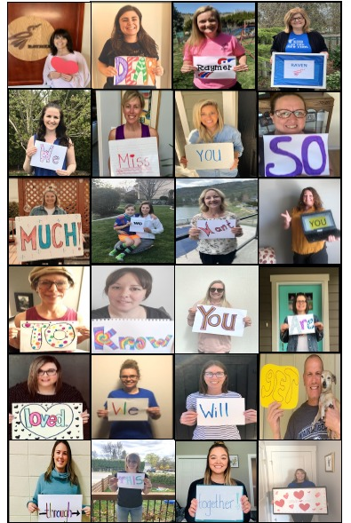
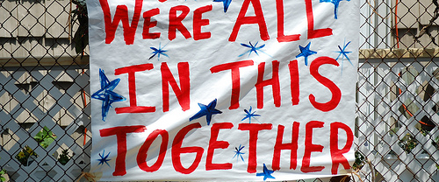
Let’s Have a Tremendous Tuesday! May 19th – May 22nd

Slide 2
Remember: My Job/ Your Job - Our VALUES We ARE A CARING TEAM, EVEN WHEN LEARNING ONLINE ☺
Learn
Work with others
Think for myself
Make decisions
Come each day at home prepared to work
Ask when I don’t understand
Give teacher something to assess/evaluate
Self evaluate
Follow our class guidelines
Make plans and do the work
Share our beliefs (about how we do things in our classroom)
Be prepared (e.g., homework supplies)
Treat others with respect
Use/participate in restitution process (positive problem solving

Slide 3
ETIQUETTE Co-Constructed
PLEASE “DO”
BE TIMELY. ARRIVE EARLY FOR VISIT ☺
SIT/STAND IN ONE PLACE.
BE RESPECTFUL OF EACH OTHER
PARTICIPATE & SHARE
LOOK AT THE CAMERA
USE CHAT APPROPRIATELY
WEAR HEADPHONES IF YOU HAVE THEM
MONITOR BACKGROUND NOISES

Slide 4
Zoom Goals Today Tues., May 19th, 2020
We can: Share Weekend Highlights Review “W.A.G.” & Daily 3 Goals Breakout –Share Poetry & UN Mini Inqury Goals Review Poetry Rubric Know Sexual Health Zoom Info Learn our COVID-19 Parody – Part 1! “Be Kind to Yourself” – Ms. May Wellness Activity Wrap Up / Take Q’s

Slide 5
First, Share a Long Weekend Highlight
Attendance

Slide 6
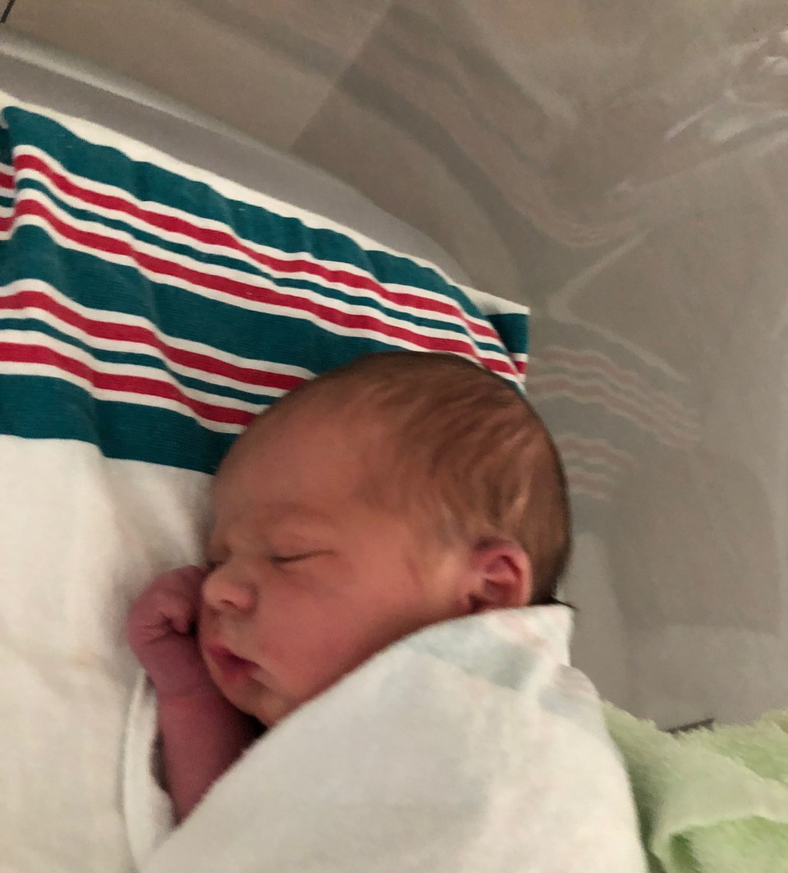
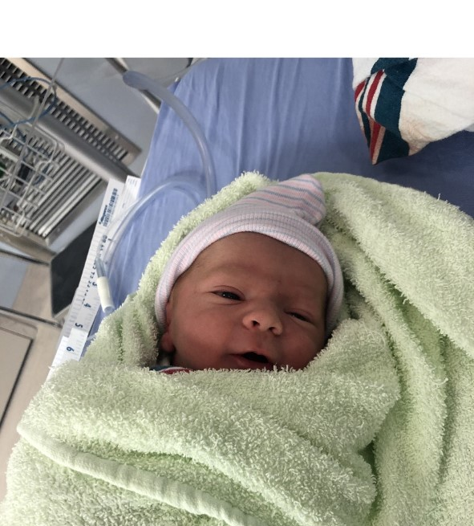
My Turn! I’m a Grandma!
Introducing Bodhi Quinn Samaddar 7 LBS 11 Ozs
Born 3:11 a.m., Sunday, May 18th, 2020

Slide 7
WEEK AT A GLANCE & DAILY 3’S

Slide 8
MATH TODAY
Area & Perimeter – Google Form – Start early tomorrow on exercises

Slide 9
THINK LIKE A READER! Mini Inquiry Integrated Study: Create Your Slide Deck (ELA/SS/SC)
Create your slide deck.
Insert information into template provided by Mrs. S
Add “extra” slides if you
Did you share your notes with me? Need more info – check out Team Samaddar Website.

Slide 10
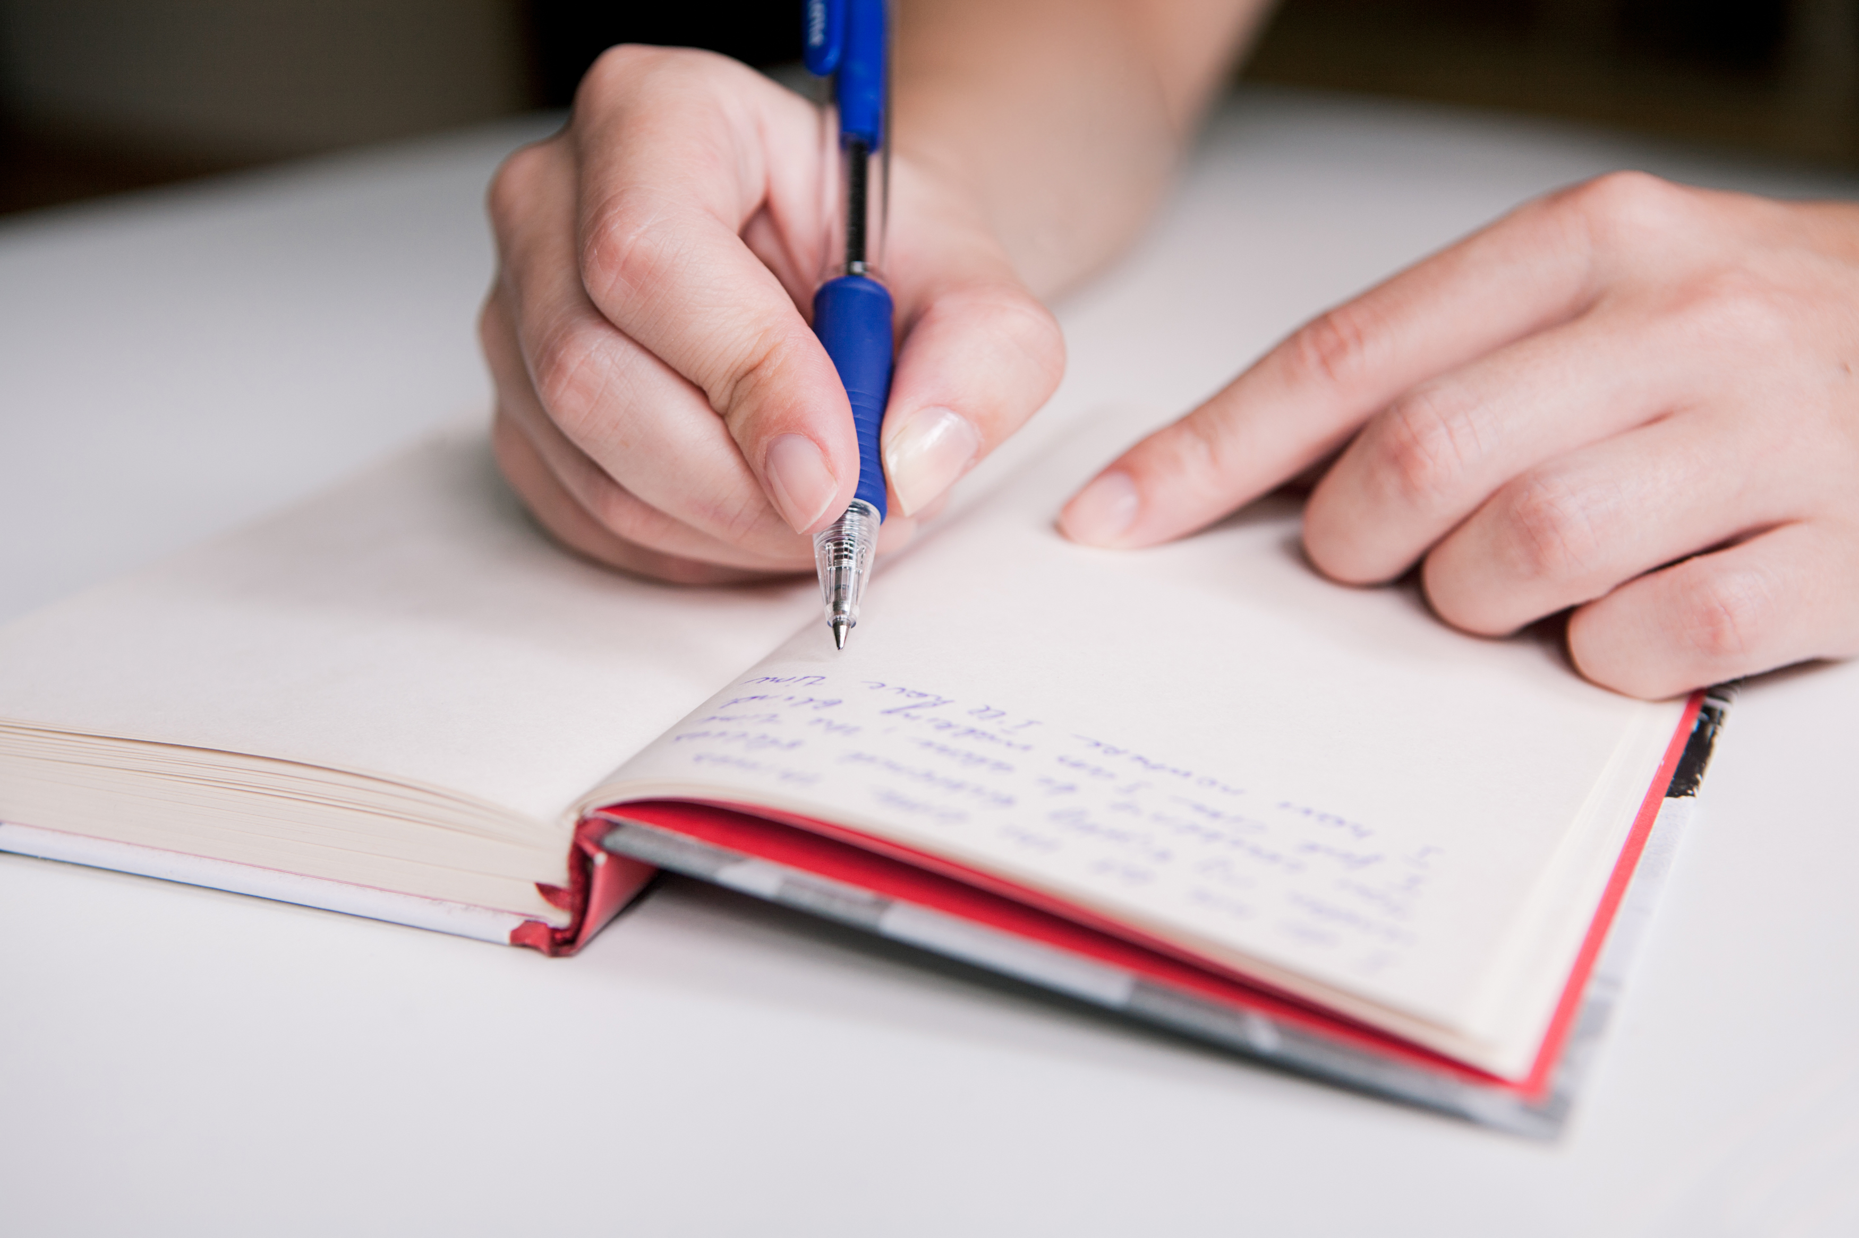
No Journalling this Week
Past Work:
Did you post your FAV journal or thank you note last week?
I am checking FreshGrade this week.

Slide 11
THINK LIKE A WRITER!
What makes a quality poem?
LET’S LOOK AT OUR RUBRIC!

Slide 12
BREAK OUT!☺ – SHARE 2 THINGS
WHAT TYPE OF POEM ARE YOU PLANNING FOR #3
NOTES FOR UN GOAL?
HOW ARE THINGS GOING?

Slide 13
COVID-19 PARODY PART 1
LET’S DO IT!

Slide 14
SEXUAL HEALTH ZOOM LESSONS
http://pamsamaddar.weebly.com/sexual-health-links.html
Grade 6 - Wed 9:30 a.m., Thurs 11:00 a.m. and Fri 1:30 p.m.
Grade 5 - Wed., 11:00 a.m. (next week #2 session is Wed., 9:30 a.m.

Slide 15
Check Out MS. MAY’S MENTAL WELLNESS IDEAS #6
What are we doing today?
A new Go Noodle!

Slide 16
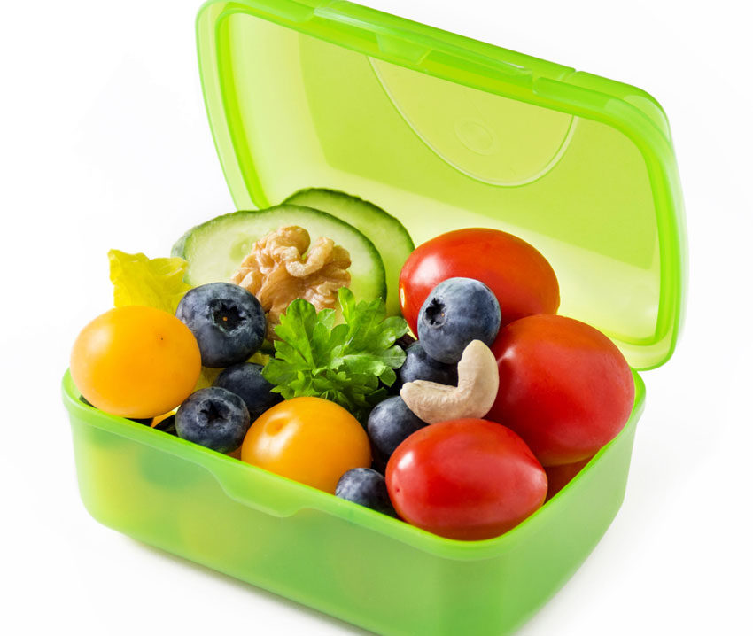
REMEMBER to KEEP WELL
HEALTHY SNACK? ACTIVITY BREAKS?

Slide 17
RECAP

Slide 18
Daily 3 - ARE YOU ON TRACK? ☺
Think Like a Mathematician | Think Like a Reader (1) | Think Like a Writer (2)
Tues/Wed – Google Form Area & Perimeter Thurs / Fri – Perimeter will be posted Past Work INTRO TO METRIC “exercises” Metric Worksheets – optional FRACTION UNIT REFLECTION | Google Slide Deck (UN Sustainable Development Goal Mini Inquiry) – due Friday – use Mrs. S’s Google Slide Deck Still time to gather more notes. Share what you did last week with me. SIMBI /RAZ = 1 ENTRY D.E.A.R. | POEM #3 – Plan/Draft by Friday Past Work – Poems #1 & #2 are done Extend? Try another 1-2 poems. No Journalling this Week – Get mini inquiry done ☺

Slide 19
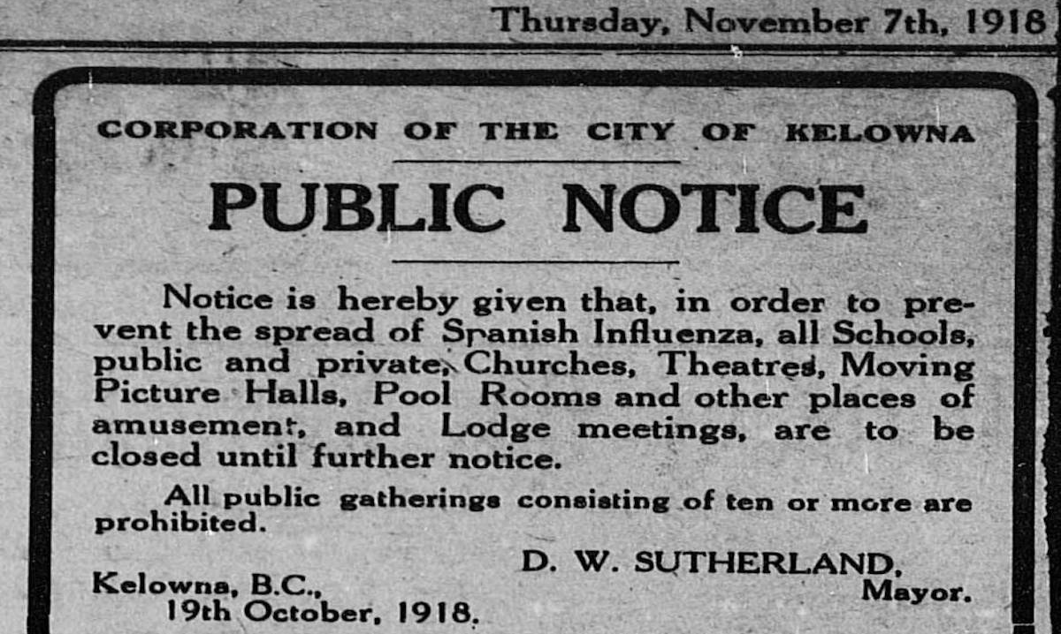
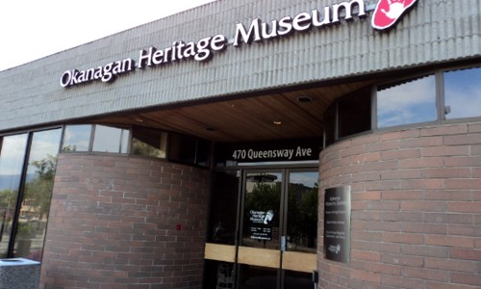
Okanagan Outbreaks Kelowna Museum – Going Deeper Shawn Talbot Inspires!
What stories will future historians tell about our historic time living with COVID-19 pandemic (100 years from now)?
Coming Soon…Kelowna Museum Project

Slide 20
Everybody Needs a Rock
This book and lesson invites us to engage in a wonderful “outdoor” activity, as well as an act of community kindness!

Slide 21
Routines! Routines!
Keep Well-Rested
A “REGULAR” schedule will help you best your best self

Slide 22
Opportunity to Extend! Student Voice/Choice
NEW IDEAS?

Slide 23
30-DAY GRATITUDE PHOTO CHALLENGE DUE BY END OF MAY
REMEMBER….

Slide 24
Always Check Out – Our Amazing Website!
STUFF FOR YOU, STUDENT
New Resources – especially for GOOD READS
STUFF FOR PARENTS!

Slide 25
May 20th-22nd
ZOOM MEETINGS 40 minutes Code: 901-214-8642 | VICTORIA DAY NO SCHOOL |  | 9:30 Gr. 6 S.H. 11:00 Gr. 5 S.H. | 11:00 GR. 6 S.H. Gr. 5 w/ Mrs. S 11:58 | Fri WHOLE CLASS 8:30 – 9:10 1:30 Gr. 6 S.H.
Join Zoom Meeting https://sd23.zoom.us/j/9012148642 Meeting ID: 901 214 8642
Watch for news about returning in person week of June 1st.

Slide 26
Just Before You Go?
Small Reading Group 1:08 Today.

