Slide 1
Team Samaddar Connect-Learn-Grow Week Of: May 4th to May 8th

Slide 2
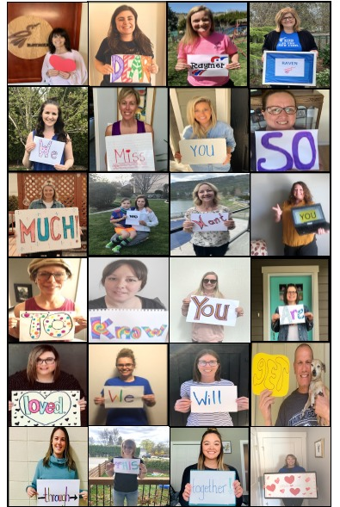
Mon., May 4th Mindset Monday & It’s Mental Health Week in Canada
Remember: Wacky Wednesday – Favourite PJ’s Day!

Slide 3
STRONGER TOGETHER - BE INSPIRED!
LEAN ON ME – CANADIAN PERFORMERS + PRIME MINISTER TRUDEAU https://www.youtube.com/watch?v=athd5_CW_z0

Slide 4
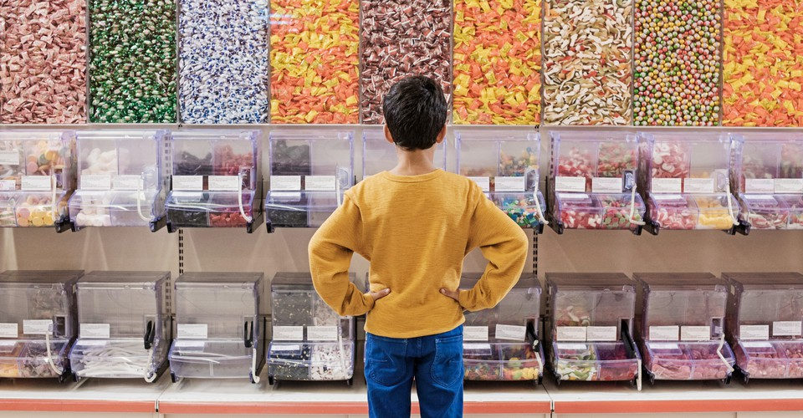
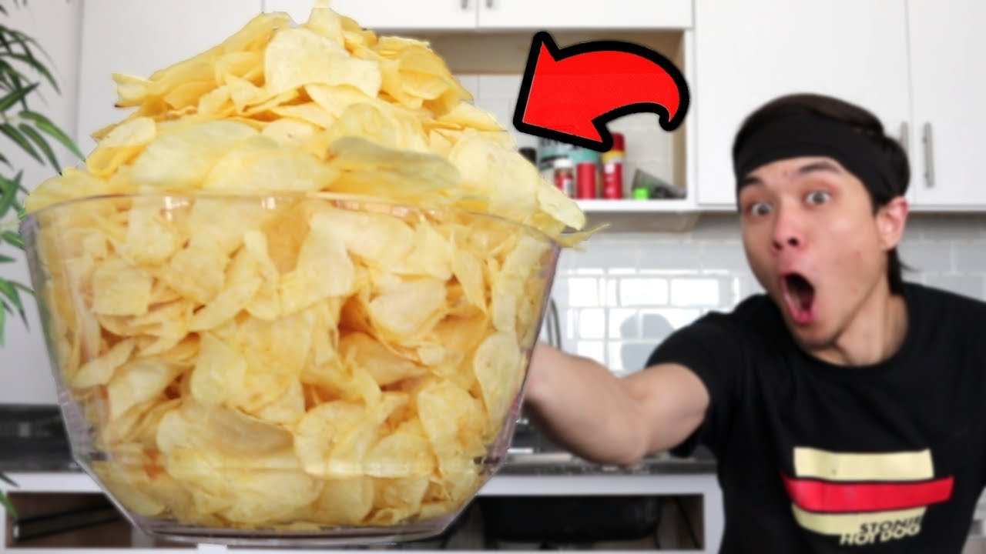
Attendance Would you rather have…
OR UNLIMITED
CANDY TO EAT?
an unlimited amount of chips
Chat Leader Today?

Slide 5
My Job/ Your Job - Our VALUES! We ARE A CARING TEAM, EVEN LEARNING FROM HOME!
Learn
Work with others
Think for myself
Make decisions
Come each day at home prepared to work
Ask when I don’t understand
Give teacher something to assess/evaluate
Self evaluate
Follow our class guidelines
Make plans and do the work
Share our beliefs (about how we do things in our classroom)
Be prepared (e.g., homework supplies)
Treat others with respect
Use/participate in restitution process (positive problem solving

Slide 6
ETIQUETTE Co-Constructed
PLEASE “DO”
THIS MEANS….PLEASE “DON’T”
BE TIMELY. ARRIVE EARLY FOR VISIT ☺
SIT/STAND IN ONE PLACE.
BE RESPECTFUL OF EACH OTHER
PARTICIPATE & SHARE
LOOK AT THE CAMERA
USE CHAT APPROPRIATELY
WEAR HEADPHONES IF YOU HAVE THEM
MONITOR BACKGROUND NOISES
Leave
Drink unhealthy drinks – water is best –keep away from device
Interrupt Others
Be Distracted (e.g., TV, music, cooking, pets; make weird noises, mess with backgrounds, use your phone, play video games
Lay on a bed
Avoid Emoji’s in Chat Box

Slide 7
Learning Intentions Monday, May 4th
Are you TURNING IN WORK in GOOGLE CLASSROOM?
Report coming end of week!
Watch Video on
TECH TIPS again, if unsure ☺
HOW ARE YOU DOING?
We can: Be Mindful Participate in Canada’s Mental Health Week Go Deeper w/ Poetry, Math & UN SDG’s Understand why SIMBI is GREAT! Collaborate on a Q.O.D & Parody breaking out!

Slide 8
Break Out to Contribute Ideas in Zoom Quote of the Day Let’s Focus on a Growth Mindset!
Tell Us @ Zoom Meeting
(1) What the quote means in your own words
(2) How could you apply this quote to yourself (connect to self)
(3) What can the world learn from this quote? (connect to world)

Slide 9
Let’s Begin with Thinking About Mental Health Week in Canada
TAKE ACTION:
WHAT IDEA WILL YOU PICK FROM RAYMER’S MENU?
For Us….
Check Out MS. MAY’S MENTAL WELLNESS IDEAS

Slide 10
Daily 3 Today
Think Like a Mathematician (2?) | Think Like a Reader (1) | Think Like a Writer (2)
# 1 Exit Ticket if not done, yet #2 New Lesson: Video Exercises Check Answers Common Denominators (Equivalent Fractions the "Easy Way") https://mathantics.com/lesson/common-denominator-ecd | #1 Simbi (Book #3) Read Along, Read Aloud, Retell | #1 Poetry Devices – Choose & Complete 1 Task #2 Journal Entry Select a new prompt – see Choice Board Doc Interested in Regional District Poetry Contest? (Intro @ Zoom)

Slide 11
MATH LESSON (Mon/Tu)
Common Denominators (Equivalent Fractions the "Easy Way")
https://mathantics.com/lesson/common-denominator-ecd

Slide 12
Why Simbi? https://simbi.io/
You can make a difference
Being a global citizen becomes real to us!
Help children around the world to read!
How can we not use it!
TRY TO MAKE A DIFFERENCE IN THE WORLD

Slide 13
THINK LIKE A READER/WRITER #1 See “STREAM” Poetic Terms & Devices
CHOOSE ONE TASK
#1 POETIC TERMS – Check out this site and share 5 new things that you learned about poetic terms. Share IN BOX below LINK:
http://www.writing.upenn.edu/~afilreis/88/poetic-terms.html
#2 EXPLORE FEATURES OF RHYME ZONE - Check out this site and answer two questions in the box below LINK:
http://www.rhymezone.com/

Slide 14
Writing Opportunity! Poetry Contest
Central Okanagan residents with a flair for crafting words into poetry are encouraged to take part in the Okanagan Shines Spring Poetry contest.
The contest, hosted by Regional Parks, the RDCO Waste Reduction Office and Central Okanagan Economic Development Commission, is open to poets aged five years old and up.
Poets can choose between two topics - a celebration of spring, or an RDCO regional park - and write about how nature inspires them.

Slide 15
Poetry Contest Cont’d
The contest runs from May 1 to 14 and winners will be announced on May 21.
Nine prizes will be awarded by age group and topic, including the grand prize of a $100 gift card to a local business for Best Overall Poem.
Entries must include name, age, phone number and home address.
Email your entry to eeco@rdco.com with the topic you've chosen in the subject line.
For contest rules, visit the website.
https://www.regionaldistrict.com/media/283647/Okanagan_Shines_Poetry_Contest_Guidelines.pdf

Slide 16
THINK LIKE A WRITER #2 Journal Writing – 1 of 2 Entries this Week (M/Tu)
Select a topic and complete two journal entries
Post your FAV later in the week to FreshGrade
Need a Topic – Check out “Writing Stuff” on Team Samaddar Website or
Journal Writing Folder in Google Classroom

Slide 17
What are the Sustainable Development Goals?
Become the Expert On One!
11 Team Up! 6 Work on Your Own
ANNOUNCE IN GRADE GROUPS TOMORROW

Slide 18
What is Sustainable Development?
https://youtu.be/7V8oFI4GYMY

Slide 19
From MDGs to SDGs No Point Going Halfway
https://youtu.be/DdLqiTvFwJk

Slide 20
BREAK OUT NOW!
Let’s Compose a Parody – Draft #1

Slide 21
Routines! Routines!
Keep Well-Rested
A “REGULAR” schedule will help you best your best self

Slide 22
Opportunity to Extend! Student Voice/Choice
Research to explore and learn about a leader (past and present) and the impact they’ve had on society.
Is there a leader in your community who inspires you?
Listen to Chief Seattle’s speech & compare to The Elders Are Watching
Participate in Regional District Poetry Contest!

Slide 23
Always Check Out – Our Amazing Website!
STUFF FOR YOU, STUDENT
New Resources – especially for GOOD READS
STUFF FOR PARENTS!

Slide 24
Just Before You Go?
Reflect on Your Behaviour at Zoom Meetings. How can you “be” better?

Slide 25
Opportunity to Extend! Student Voice/Choice
Research to explore and learn about a leader (past and present) and the impact they’ve had on society.
Is there a leader in your community who inspires you?
Listen to Chief Seattle’s speech & compare to The Elders Are Watching
Participate in Regional District Poetry Contest!

Slide 26
Routines! Routines!
Keep Well-Rested
A “REGULAR” schedule will help you best your best self

Slide 27
Check It Out – Our Amazing Website!
STUFF FOR YOU, STUDENT
New Resources – especially for GOOD READS
STUFF FOR PARENTS!

Slide 28
April 27th-May 1st
ZOOM MEETINGS 40 minutes Code: 901-214-8642 | M Whole Class 11:58 | Tu Grade Level Gr. 5 10:30 a.m. Gr. 6 11: 58 a.m. | Wed Whole Class 10:30 a.m. Lunch Invite: 11:30 a.m. (15) | Th Grade Level Gr. 6 9:50 a.m. Gr. 5 11:58 a.m. | Fri Whole Class 8:30 – 9:10 Lunch Invite 11:15 a.m. (15)
Join Zoom Meeting https://sd23.zoom.us/j/9012148642 Meeting ID: 901 214 8642
Other Zooms. See Mrs. Schultz & Mrs. Boulanger Schedules

Slide 29
Just Before You Go?
Stay in Zoom if you have questions or wish to have a longer extra visit

Slide 30
Wait for Zoom Meeting Excited to See You All! Have your whiteboard & marker handy ☺
Join Zoom Meeting https://sd23.zoom.us/j/9012148642 Meeting ID: 901 214 8642

