Slide 1
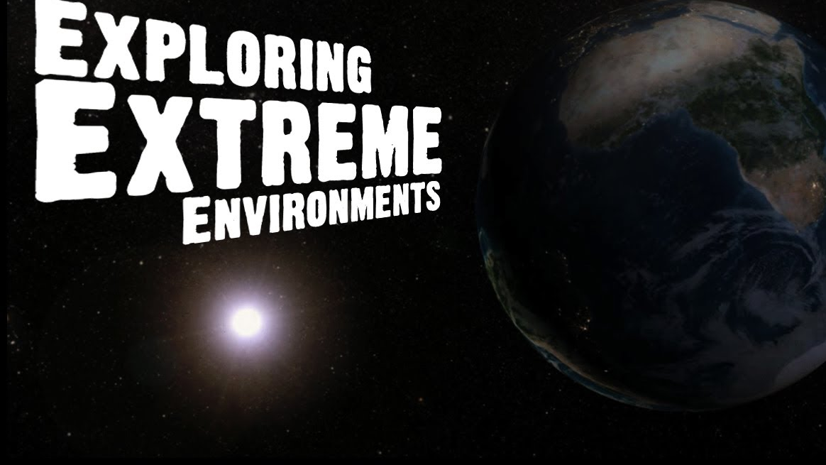
INQUIRING MINDS: Be Curious/Keep Learning
Team Samaddar Integrated Study: ELA / Science / Socials Studies

Slide 2
Materials Needed Check Team Samaddar Website & Google Classroom
#1 BEFORE THE READ – June 1st - 5th
Activate Thinking Docs
1) What do humans need to survive? Day 1
2) Staying Alive: What every person needs Day 2
Unit Intro - Mrs. S’s Exploring Extreme Environments PowerPoint

Slide 3
Materials Needed Check Team Samaddar Website & Google Classroom
#2 & #3
DURING THE READ June 8th – 15th
Articles (In Class – Books / At Home – See scanned copies in Google Classroom or Website)
Going to Extremes P. 104 – P. 108 (Work is completed on Google Doc “Going to Extremes” – make your thinking visible/show comprehension Due by Wed, June 10th
Science to the Rescue P. 109 – 112 (Read before coming to Zoom or in class. Answer question in Google Classroom to make your thinking visible). Individual Paragraph on a Technology of Choice Due by June 15th.

Slide 4
2. Going to Extremes Share June 10th
Monitor Comprehension
3. Science to the Rescue Due by June 15th
1. Access Background Knowledge / Unit Intro – June 1st-5th
4. Mission to Explore
Contribute to Digital Log (“Story Book”
Using Terminology Demo Task
Due June 19th

Slide 5
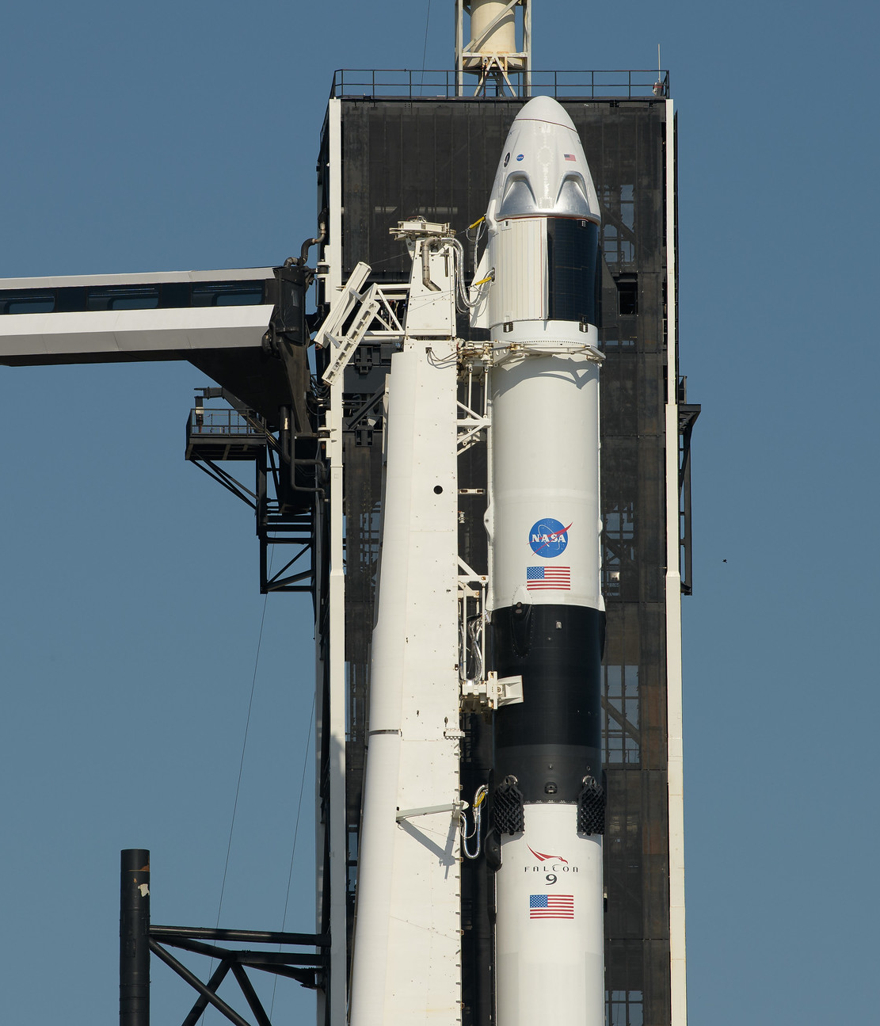
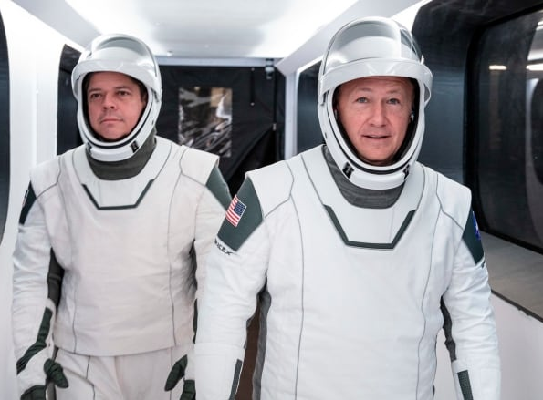
Before We Begin! Dragon / Space X Launch DID YOU WATCH IT, LIVE? Be Inspired…
HISTORICAL EVENT IN SPACE TRAVEL
7:16 a.m. May 31st Successful Arrival On Board the International Space Station (ISS)
Go Ahead 10:00 a.m. to open Hatch
Board ISS @ 10:23 a.m.
First Time Ever in 9 Year! First Time Every for Commercially Built Craft
Let’s Watch & Be Inspired!

Slide 6
Activate Our Thinking in Zoom Staying Alive: What Every Person Needs
Mrs. S Reads the Question – What is the Answer?
Radiation from the Sun can be harmful
B. Humans need food and water daily.
C. Our heart and lungs need a constant temperature, close to room temperature, to function properly.
D. Breathable air is vital to our survival.
Proper air pressure, caused by the particle of the air around us, helps us breathe and keeps our blood from boiling.
Our circadian rhythm, which keeps our bodies clocks working smoothly, is dependent on natural light.

Slide 7
Guiding Questions
What do humans need to survive?
How has the exploration of extreme environments on Earth and space changed in recent times?
How has technology affected human’s discovery, extraction, processing and marketing of selected resources throughout history?
How can we act as stewards of our environment?

Slide 8
LEARNING TARGETS Together, We Can:
Monitor our comprehension (understanding)
Stop reading and restate important concepts to check your understanding
Use examples to check your understanding of concepts
Use terminology in your speaking and writing
Use visual information to confirm or deepen your understanding of the text
Explore and learn about extreme environments
Collaborate to gather facts informational text & share in a class Digital Log (“Story Book)
Use terminology related to a specific technology

Slide 9
Self Assessment
Strategies | Not Yet | Sometimes | Usually | Always
I monitor my comprehension to make sure I understand what I read – see also strategy rubric
I use terminology to give my speaking/writing authority – see demonstration task rubric
I share to contribute my ideas in groups and whole class discussions
I collaborate well with others to contribute information about one extreme environment
What helped me the most is…..because….

Slide 10
#1 Accessing Background Knowledge
Jot Your Thoughts to Each Question in Google Doc
Be Prepared to Share in Class Discussion
Day 2 or Wed Zoom (June 3rd)

Slide 11
What would you need to survive in a mouth-parching desert?

Slide 12
What would you need to survive in the deep ocean?
Notes:
Deserts

Slide 13
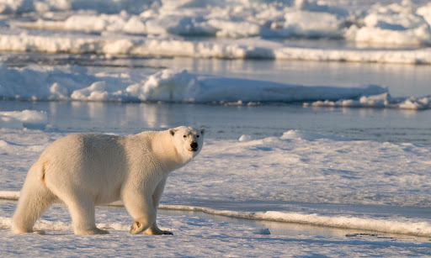
What would you need to survive in the polar regions?
Notes:
Deep Ocean

Slide 14
What would you need to survive in a lava-spewing volcano?
Notes:
Polar Regions

Slide 15
What would you need to survive in gravity-defying outer space?
Notes:
Volcanoes

Slide 16
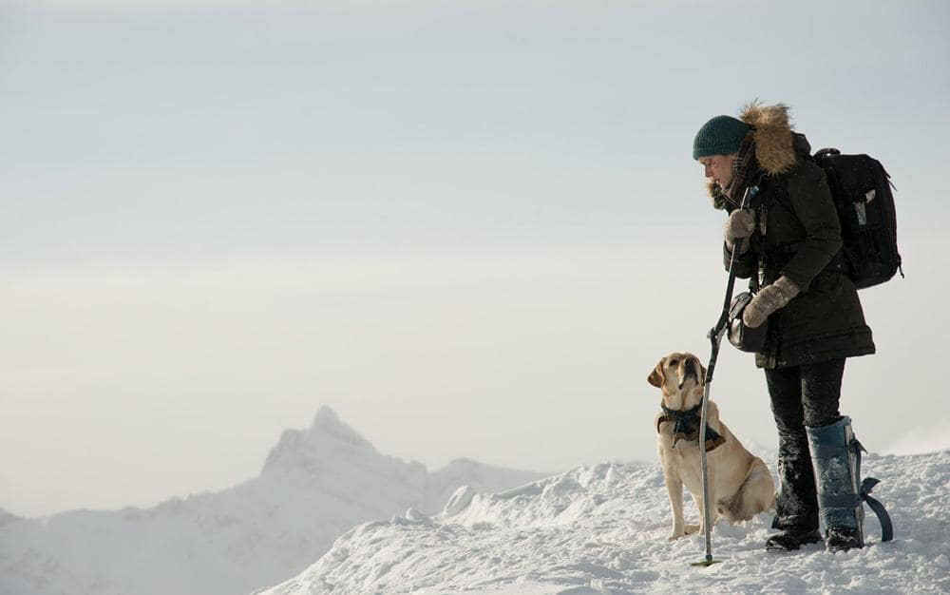
What would you need to survive in the highest mountains?
Notes:
Volcanoes

Slide 17
What do humans need to survive? How did we do?

Slide 18
Breathable Air
Breathable air is one of the most important things we need in order to survive.
Humans can’t breathe underwater without special equipment, which makes the ocean an extreme environment.
Some extreme environments, like the deep ocean, are uninhabitable to us because there is no air to breathe. We can explore underwater for short periods though by wearing scuba gear, including an oxygen tank.

Slide 19
Potable Water
Humans need a steady supply of drinking water in order to survive.
Some extreme environments, like this desert, have very little water, or no clean water.
Don’t count on finding an oasis when you’re in a desert like this. Bring plenty of water with you, or you may not survive a long trek.

Slide 20
Food
Humans need food to survive.
Some extreme environments have no food at all.
This is astronaut James Voss aboard the International Space Station. Astronauts like James need to take their own food into space because there is none there. Astronauts also need to store their food securely so it doesn’t float around in the microgravity environment.

Slide 21
Moderate Temperature
Humans can only survive in environments of a certain temperature range.
Too hot or too cold and you will die—unless you have special protection (proper clothing and shelter for the weather).
During the winter, Inuit families follow the hunt. The igloo or snow house is the perfect home for the bitterly cold Arctic winter. Made of snow and ice, the igloo protects its inhabitants from the harsh elements. Snow never drops below 0º Celsius, so it’s never that cold inside an igloo.

Slide 22
Source of Light
Humans need a certain amount of natural light in order to be healthy.
Natural light helps us sleep better, improves our moods, and boosts our body’s vitamin D storage.
You hear stories about people who get depressed in the winter when it’s dark a lot, but it’s tough being in a place where it’s bright ALL the time, too. In January in Antarctica, the sun never goes down. Try getting sleep when the sky is lit up all night long!!

Slide 23
Proper Air Pressure
For humans to survive, the air pressure needed in our lungs, ears and stomachs must be the same as the air pressure outside our bodies.
The standard atmospheric pressure on Earth is 14.7 pounds per square inch
On Earth, the atmosphere exerts pressure in all directions. In space, air pressure is almost non-existent.
Without air pressure, air would rush out of our lungs, gases and body fluids would expand, and our skin would expand like an inflating balloon.
Outer space is a very extreme environment requiring special equipment. A space suit is really like a one-person spacecraft. It protects the astronauts not only from the zero air pressure, but also from extreme hot and cold temperatures, dangerous radiation, and space dust. Space suits also provide oxygen to breathe and water to drink while astronauts are on space walks.

Slide 24
Week of June 8th See Assignments in Google Classroom
Reading 2 Articles:
Going to Extremes (Individual Work)
Science to the Rescue (Participate in Whole Class Discussion)

Slide 25
What will you do to monitor your comprehension while you read?
How might this inquiry and reading practice help you in other school subjects? Grade 6 or Grade 7?
What new ideas can you add to what you already have about extreme environments?

Slide 26
Monitoring Comprehension
Often in your reading you meet words and concepts that are new or difficult to understand.
Monitoring your comprehension is a way of making sure you are understanding what you are reading.
Notes:
Outer Space

Slide 27
Applying Strategies Monitoring Comprehension
Stop and restate important concepts to check your understanding
Use examples to check your understanding of concepts.
Use visual information to confirm or deepen your understanding of the text

Slide 28
Read & Show Your Understanding “Going to Extremes” Due by Tues., June 9th (Share June 10th) See Google Docs to Do Work
P. 104 Mouth-Parching Deserts
Why can some animals and plants survive in the extreme climate of the desert?
P. 105 Lung-Crushing Deep Ocean
Why is the deep ocean difficult for humans to explore?
P.106 Bone-Chilling Polar Regions
What are polar regions considered extreme environments?
P. 107 Lava-Spewing Volcanoes
Why are volcanoes so dangerous? How do volcanoes erupt?
P. 108 Gravity-Defying Outer Space
Why is space the ultimate extreme environment?
What other environments can you think of that are extreme?

Slide 29
Science to the Rescue
Humans cannot live in extreme environments without some help.
These environments are just too hot or too cold or too dangerous for us.
But that doesn’t stop us from wanting to explore them and learn more about them.
Fortunately, we have a secret weapon - science

Slide 30
Let’s Go Deeper Exploring Extreme Environments
LET’S ACTIVATE OUR THINKING
LET’S COMPOSE DIGITAL STORYBOOK
Scientists have come up with new technologies and materials that allow us to explore and sometimes even live in extreme environments.

Slide 31
Using Terminology
When you use terminology, you show listeners or your audience that you know what you’re talking about.
For example, in writing about volcanoes, you would use the term volcanologist rather than saying a “person who studies volcanoes.”
Science, sports, mathematics, and many other areas use terminology – technical words that have a precise meaning.
When you are drafting or revising a piece of writing, using terminology gives your writing authority.

Slide 32
Chris Hadfield (Astronaut) & James Cameron(Deep-Ocean Explorer
Create a T-Chart. Label one column “Deep Ocean” and the other “Space.”
Watch & describe what it is like to enter extreme environments.
Compare how the experiences of Hadfield & Cameron were similar and different.
Videos
https://www.youtube.com/watch?v=v5DG5Eup9ss (James Cameron)
https://www.youtube.com/watch?v=DZnh4t8VJOA (Chris Hadfield)
Share your thinking

Slide 33
PART II – Practice The Attributes of a Learner Learn. Think. Collaborate. Contribute. Innovate
Deserts | Polar Regions | Volcanoes | Space | Deep Sea
Describe technologies/materials specifically used or designed to explore your extreme environment.

Slide 34
Class Google Docs Project About Exploration
From a list of provided topics on Exploring Extreme Environments and Related Technologies use terminology to:
Explore your topic
Use correct terminology in your notes and include definitions to help your reader.
If needed, use an online dictionary to make sure you understand the terminology.
Reread your “log” and make changes to include correct terminology, best image, captivating video on your topic

Slide 35
Materials Needed Check Team Samaddar Website & Google Classroom
#4 After the Read:
Team Samaddar COLLABORATIVE team PROJECT
Digital story book (log)
Techologies / Materials Use to Explore Extreme Environments
Due by June 19th
Resources:
Team Samaddar Website – Links to Websites
Informational Text “Extreme Environments”
Science Probe Textbook Chapter

Slide 36
Go For Launch:
Together, let's compose a digital log, entitled Team Samaddar Extreme Environments' Digital Story Book, outlining how scientists have come up with new technologies and materials that allow us to explore and sometimes even live in extreme environments
Assigned in Order of Discovery - Put your name in first column above topic

Slide 37
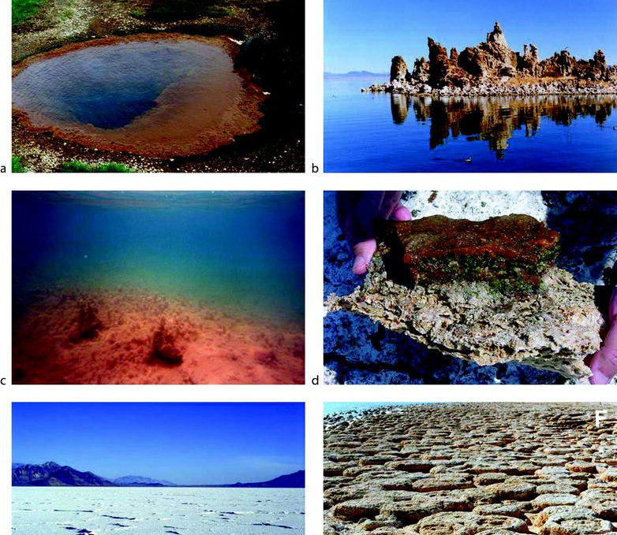
Your Mission:
Explore to discover,
An IMAGE that best represents your topic,
"Did You Know?" important facts about your technology or material related to exploring and/or living in an extreme environment, and
A link to a video that informs and sparks the curiosity for us and our spectators
Check out to begin your journey!
http://pamsamaddar.weebly.com/extreme-environments-inquiry.html

Slide 38
Resources
Nelson Literacy Teacher’s Resource Exploring Extreme Environments
BC Open Schools
https://www.openschool.bc.ca/ocr/science/sc6ee/
Extreme Environments Inquiry Project

Slide 39
Further Learning Ahead

Slide 40
National Geographic Search for life in volcanoes and other extreme environments
https://www.youtube.com/watch?v=WLpam8jMp-o
Found everywhere from the rim of a lava lake to the inside an iceberg, microbes are remarkable organisms that can live in places humans can only dream of. How do they do it? And what can we learn from them about the limits of life both on our planet and elsewhere in our solar system?

Slide 41
Extend? National Geographic Challenge
https://www.nationalgeographic.org/media/extreme-environments/

