Slide 1
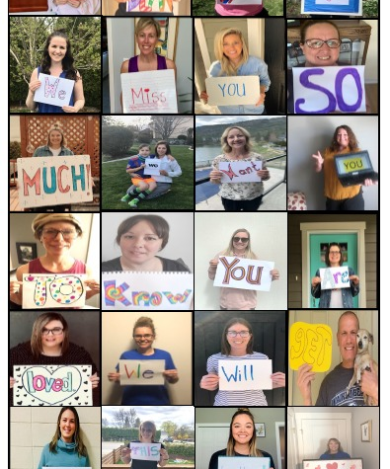
Tues., May 12th BEGINS HERE Zooms Today Gr. 5 10:30 a.m. Gr. 6 11: 58 a.m. + Reading Group 1:08

Slide 2
Learning Intentions Today Tues., May 12th
Kahoot Today – Bring a 2nd device if you can ☺
We can: Reflect on Q.O.D. Look at Ms. May’s Wellness Menu Complete Work w/Daily 3’s Breakout for Peer Feedback Poem #1 Review fractions with a Kahoot Breakout Re: Museum Zoom yesterday Plan for “Wacky Wed”! Other?
Wacky Wednesday Tomorrow!
Share your appreciation of nature in a creative way!

Slide 3
Remember: My Job/ Your Job - Our VALUES We ARE A CARING TEAM, EVEN WHEN LEARNING ONLINE ☺
Learn
Work with others
Think for myself
Make decisions
Come each day at home prepared to work
Ask when I don’t understand
Give teacher something to assess/evaluate
Self evaluate
Follow our class guidelines
Make plans and do the work
Share our beliefs (about how we do things in our classroom)
Be prepared (e.g., homework supplies)
Treat others with respect
Use/participate in restitution process (positive problem solving

Slide 4
May 11th to May 15th
ZOOM MEETINGS 40 minutes Code: 901-214-8642 |  | Tu Grade Level Gr. 5 10:30 a.m. Gr. 6 11: 58 a.m. Reading Groups 1:08 | Wed Whole Class 10:30 a.m. Lunch Invite: 11:30 a.m. (15) Reading Group 1:00 | Th Grade Level Gr. 6 9:50 a.m. Gr. 5 11:58 a.m. | Fri Whole Class 8:30 – 9:10 Lunch Invite 11:15 a.m. (15)
Join Zoom Meeting https://sd23.zoom.us/j/9012148642 Meeting ID: 901 214 8642
Other Zooms. See Mrs. Schultz & Mrs. Boulanger Schedules

Slide 5
Share Thoughts Of: Quote of the Day Let’s Focus on a Growth Mindset!
(1) What does the quote means in your own words
(2) How could you apply this quote to yourself (connect to self)
(3) What can the world learn from this quote? (connect to world)

Slide 6
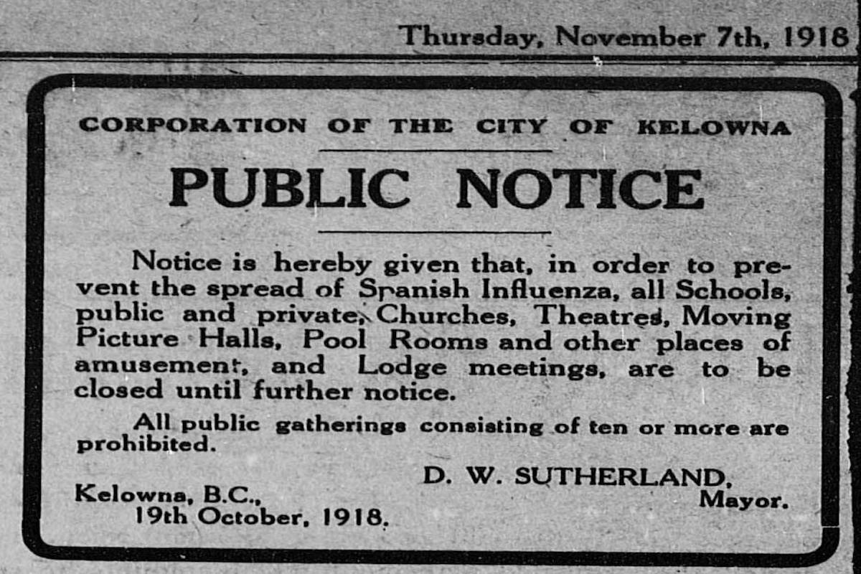
Kelowna Museum Virtual Field Trip Be a Thinker – Breakout & Share
Okanagan Outbreaks
Meet people from local history who lived through epidemics like the Spanish Flu and Polio.
What did you discover about how they responded when disease swept through their community?
What stories of courage and homey resilience give us hope?
What stories will future historians tell about us?

Slide 7
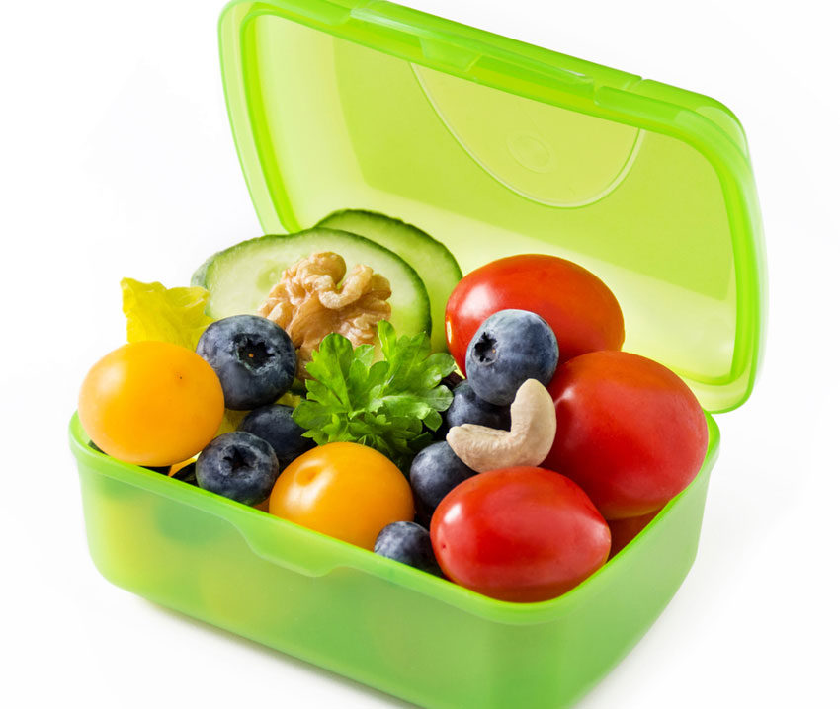
REMEMBER ☺
WHEN DID YOU SNACK, HAVE LUNCH, BUILD IN YOUR BREAKS TODAY?

Slide 8
Check Out MS. MAY’S MENTAL WELLNESS IDEAS

Slide 9
Daily 3 Today (Same as Monday)
Think Like a Mathematician (2?) | Think Like a Reader (1) | Think Like a Writer (2)
Review work with fractions – FreshGrade, Exit Tickets, Google Classroom Be ready for a Kahoot– Bring 2nd Device | Read/View UN Sustainable Development Goals See http:pamsamaddar.weebly.com; Gather notes – share w/ Mrs. S Helpful Resources…UN Sustainable Goals Page Simbi Read Along, Read Aloud, Retell | Share poem draft #1 in Zoom today #1 Journal Entry or a special note to make someone smile Regional District Poetry Contest? Share w/ Mrs. S

Slide 10
MATH TODAY - NO LESSON
Tuesday – REVIEW FRACTION WORK DAY 2
REFLECT WEDNESDAY

Slide 11
THINK LIKE A READER! Mini Inquiry Integrated Study: ELA, SS & Science Gather notes for this week – aim for Friday to have all notes
Read/View Information on Your UN Sustainable Goal
Jot notes in document in Google Classroom (Share document w/ Mrs. S to follow along)
Gather notes – all notes are due by Friday – work on Google Slide Deck next week

Slide 12
THINK LIKE A WRITER!
What makes a quality poem?
Breakout #2 for PEER Feedback

Slide 13
THINK LIKE A WRITER – Choice A or B?
A. Journal Writing
2 Entries this Week
Post your FAV later in the week to FreshGrade
B. 1 Journal + 1 Thank you note to make someone smile

Slide 14
Other?
Slides 16-21 REFLECT

Slide 15
Routines! Routines!
Keep Well-Rested
A “REGULAR” schedule will help you best your best self

Slide 16
Opportunity to Extend! Student Voice/Choice
Research to explore and learn about a leader (past and present) and the impact they’ve had on society. Is there a leader in your community who inspires you?
Listen to Chief Seattle’s speech & compare to The Elders Are Watching
Participate in Regional District Poetry Contest!

Slide 17
30-DAY GRATITUDE PHOTO CHALLENGE DUE BY END OF MAY
REMEMBER….

Slide 18
Always Check Out – Our Amazing Website!
STUFF FOR YOU, STUDENT
New Resources – especially for GOOD READS
STUFF FOR PARENTS!

Slide 19
Just Before You Go?
REMEMBER TO COMPLETE YOUR BEGINNING OF THE WEEK CHECK IN
DUE BY TODAY – TUESDAY, MAY 12TH ☺

Slide 20
ETIQUETTE Co-Constructed
PLEASE “DO”
BE TIMELY. ARRIVE EARLY FOR VISIT ☺
SIT/STAND IN ONE PLACE.
BE RESPECTFUL OF EACH OTHER
PARTICIPATE & SHARE
LOOK AT THE CAMERA
USE CHAT APPROPRIATELY
WEAR HEADPHONES IF YOU HAVE THEM
MONITOR BACKGROUND NOISES

Slide 21
WACKY WEDNESDAY
CREATIVELY SHARE A WAY YOU CONNECT TO NATURE

