Slide 1
It’s a Thrilling Thursday, Sept. 3rd! We made it to Day 3!
Please be ready with:
Pen / Pencil
A 8-1/2 X 11 paper to reflect (4 Quadrants - “Aha’s, Celebrations, for My Classes, In the Future)
Water / Beverage “for your enjoyment” – hydration
Teacher Inventory on Differentiation Practices & Strategies
Silently, on your own, complete Teacher Inventory of Differentiation Practices & Strategies.
This inventory is designed for you to reflect on your practices. You may share, if you wish. Stay tuned!
“Sh”! ☺
Please respect your colleagues “thoughtful reflection” time.

Slide 3
Reflect As We Go
“AHA” MOMENTS What are your take-aways? | CELEBRATIONS Highlight/list what you are proud of in your own practice!
MY CLASS? How might you apply or experiment with an idea/s from today? | FOLLOW-UP / THE FUTURE Are their topics, structures or strategies you would like to explore?

Slide 4
Day 2 – Look What We Accomplished Together!!
Added to Strategy Harvest – Thinking Tracks, Just Like Me (Classbuildling), 4 Corners Consensus (MTV/Group Strategy/Engagement)
“Looked Back” @ Learning Destination
Reviewed what we covered first day & our guiding questions
Tied up “loose” ends
“New day” content included:
What? Why DI ?
Rita Pierson – Every Kid Needs a Champion
Rick Wormeli
10 Important Q’s - Mindset
Steps to Designing/Implementing Lesson
Walk through a lesson

Slide 5
Even More!
Positive Classroom Management “Tips”
Routines
Modelling (“on the fly”) of how it is okay to apologize, be ourselves, and share personal stories, even if we tear up ☺☺☺
Distributed resources photocopied
Outline Strategies “Toolkit” Project w/ suggestions
“Choices” time for you to meet your goals this week in pursuit of getting your new year off to a great start!
Enjoyed meeting with candidate teachers & others of you who stayed behind. I hope your afternoon went the way YOU wanted!

Slide 6
Today?
8:30 – 10:40 Prime Time (Done!) Teacher DI Inventory of Practices – Hands Up Stand Up Pair Up! Issue IPAD Draw Tickets – Good luck! MTV & Classbuilder Three Take-a-Ways Yesterday! Line ‘Em Up (Toolkit / Project Update!) “Loose Ends” – Routines “Refresh” & Our Fav’s (Socratic-Style) Pathway to a Motivating & Engaging Classroom | 9:50-10:50 Dr. Carol Ann Tomlinson Resource (Ch.7-10) What DI principles & practices are covered within each chapter – Jigsaw/KIQ?
11:30 – 12:40 Segue into “Choices” until break – add to toolkit, prep for next week, check out bibliography of online resources and/or Student Learning Profile/Interest Card Just Like Me Intro of Yourself | 12:50 – 1:50 My Fav’s & My Weebly Site as a Tool MyEducation BC Share stories of how we try to connect/build relationships with our students Reflect Guiding Q’s

Slide 7
YOUR TOOLKIT OR “PROJECT”
Considering the needs of your students /year ahead, what do you want to focus on to meet these needs?
Through this work what will your students know and be able to do?
LINE ‘EM UP STRATEGY
Notes:
Each team has their own chart paper on. Teams have 5 minutes to write their response to the first prompt (Team members all use a single colour). Team members take 2 minutes to step back and observe connections. Team members then have 3 additional minutes to make connections and extend the conversation. Process is repeated with a second colour of pen with the second prompt (in order to make connections between the process and the product).

Slide 9
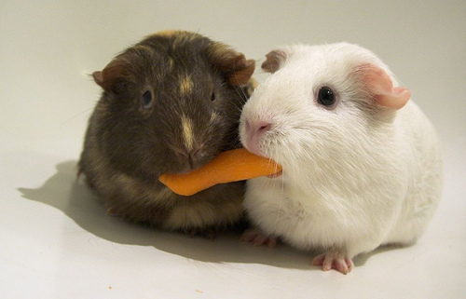
DI begins with a growth mindset, moves to student-teacher relationships and evolves to community.
Would you like to share personal stories around predictive power of mindset?
FRIDAY - We will explore and plan for ways in which we can connect to build relationships with our students as we start the school year.
Let’s Share!

Slide 10
The Bottom Line (Doubet & Hockett, 2015)
“Let’s face it: all teaching is hard, good teaching is harder, and both good teaching and differentiation call for a range of sophisticated skills that no teacher is every truly “finished” developing…Teachers can better “see” how to implement and manage differentiation in a subject or population when they have high-quality examples that they can envision transferring to their own classrooms…”
My hope that you have seen some high-quality examples that you can transfer to your own classroom setting!

Slide 11
GRADING & DI WHAT MATTERS MOST?
Where to next for me?
Refine this workshop (My first on this topic ☺)

Slide 12
Looking Back: Leading a DI Classroom What Can We Do with What We Believe! Managing a DI Classroom
Ideas will be shaped by your understanding of differentiation, your philosophy of teaching, and the degree to which you are able to share those underpinnings with your students.
Imbeau/Tomlinson remind us to think about ways in which effective leadership and management are interdependent.

Slide 13
Differentiating in Middle & High School – Doubet & Hockett
A teacher’s facility with differentiation is strongly influenced by the accuracy, depth, and breadth of his or her understanding and application of foundational aspects of teaching.
“It’s the possibility that keeps me going, not the guarantee, a sort of wager on my part.” (Ch. 1 The Notebook)
Differentiation is a sort of wager on the teacher’s part – one that risks investing time and energy into studying and knowing students well, and then responding with the best possible curriculum, instruction and assessment
NOT DIFFERENTIATING IS THE BIGGER GAMBLE.
For our money, we’ll bet on differentiation.

Slide 14
Achieving the Dream
Who will work hardest this year? You or your students?
Dream of Ruth Sutton, AFL advocate:
“That I will leave school ready to play 18 holes of golf and the students will go home exhausted.”

Slide 15
My goal has been to show that differentiation is a feasible, practical, worthwhile approach that honours classroom diversity
DI does not require you to design nine different assignments, orchestrate intricate group tasks, or put on a major production

Slide 16
Final Thought (Differentiating in Middle & High School)
A teacher’s facility with differentiation is strongly influenced by the accuracy, depth, and breadth of his or her understanding and application of foundational aspects of teaching.
“It’s the possibility that keeps me going, not the guarantee, a sort of wager on my part.” (Ch. 1 The Notebook)
Differentiation is a sort of wager on the teacher’s part – one that risks iinvesting time and energy into studying and knowing students well, and then responding with the best possible curriculum, instruction and assessment
NOT DIFFERENTIATING IS THE BIGGER GAMBLE.
For our money, we’ll bet on differentiation.

Slide 17
Rick Wormeli Admits
“As uncomfortable as it is to admit this, sometimes I retreated into survival mode and just focused on getting through the day. I console myself with the thought that this retrenchment only occurred occasionally. I recommend that you give yourself similar dispensation for these incidental lapses.
After thoroughly exploring differentiated approaches, however, I am rejuvenated, and I think you will be as well. DI provides both principles and techniques for excellent teach. It’s an effective sword against complacency.
We can raise the bar, aiming for sound pedagogy – differentiation - at least 90% of the time. We may not be able to eliminate all the pressures, but we can search for ways to teach smarter, not harder. And through our searching, we find meaning and the energy to continue”.
Differentiation: From Planning to Practice Grades 6-12, Wormeil, R. 2007. P.4

Slide 18
Last Word, Dr. Tomlinson
https://www.youtube.com/watch?v=LGYa6ZacUTM
There are multiple entry points

Slide 19
START SMALL
1. Start Small
Focus on one element in your teaching unit in one week
Use one strategy or approach from what we have covered
The following week or month, try another
Remember providing DI for all of our students, much less every student in a single class, every day, is impossible!
We must try to seek a balance between our professional and personal responsibilities
Avoid trying to incorporate all ideas at once. Choose one and really explore it

Slide 20
2. Work with a Colleague – Co-plan/Co-teach
Pick someone who knows what you are trying to do and may want to try some DI.
Provide feedback & support to one another.

Slide 21
3. Reflect:
Scroll through Powerpoints once per term. Pick one new area as a focus
Think about one resource you may want to have as your “go to” DI favourite
Take Wormeli’s top 10 questions and/or Teacher Inventory of DI practices from today and put them in a handy spot

Slide 22
Establishing a Mindset for Differentiation Ten Important Questions – Wormeli (2004)
Are we willing to teach in whatever way is necessary for students to learn best, even if the approach doesn’t match our own preferences?
Do we have the courage to do what works, not just what’s easiest?
Do we actively seek to understand our students’ knowledge, skills, and talents so we can provide an appropriate match for their learning needs? And once we discover their individual strengths and weaknesses, do we actually adapt our instruction to respond to their needs?
Do we continually build a large and diverse repertoire of instructional strategies so we have more than one way to teach?

Slide 23
Establishing a Mindset for Differentiation
Do we organize our classrooms for students’ learning or for our teaching?
Do we keep up-to-date on the latest research about learning, students’ developmental growth, and our content specialty areas?
Do we ceaselessly self-analyze and reflect on our lessons – including our assessments – searching for ways to improve?
Are we open to critique?
Do we push students to become their own education advocates and givem them the tools to do so?
Do we regularly close the gap between knowing what to do and actually doing it?

Slide 24
Other Ideas
Subscribe to EL or other mags
Share/Read – blog postings
Check out Pinterest
Conversations – staff / team meetings
Share as a mentor/school leader
Connect with leading experts - e.g., Twitter/websites
Grow your library of latest research
Book study at your school

Slide 25
A Framework for Coming Together (Imbeau/Tomlinson, 2010, p.45)
Invest some start-up time to the process – a few class periods or time slots focusing on conversations/activities related to DI
“Losing time from covering curriculum” is actually gained when a shared vision for work and routines is developed (Marzano, Pickering, 2003; Stronge, 2002)
Suggested start-up/follow-up conversations (see next slide / handout, too) – 6 key questions to help develop a shared understanding of and investment in a differentiated classroom – vary working to suit your grade (substance remains the same)

Slide 26
There is no single, tried-and-true method of differentiating instruction and assessment for all students. We do whatever works.
These past three days, in a small way, mirrors some of what a classroom can be like. My goal was to try and fit the ideas and activities around our collective group – varying in assignment, length of experience, learning styles, etc.
Even though our subject matters differ, I hope you still found strategies to incorporate into your specialty.

Slide 27
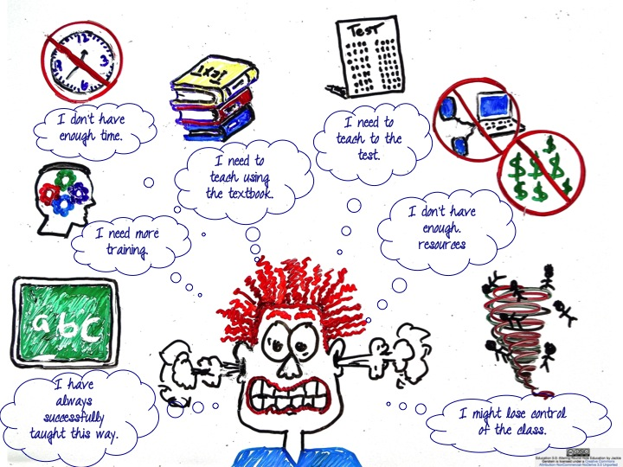

Slide 28
We’re at the End Guiding Questions?
Did I accomplish what I set out to accomplish?
What did I learn that was useful to me as an educator?
How did this learning change my thinking or practice?
What more would I like to learn about the subject?

Slide 29
In the end, all learners need our energy, our heart and our mind. They have that in common because they are young humans. How they need us, however, differs. Unless we understand and respond to those differences, we fail many learners.
(Tomlinson, 2001)
“So it is with teaching…neither to mourn what we have not done nor to rest on our victories, but rather to look at all the reasons we have to show up again tomorrow at the classroom door, ready to join our students – every one of our students – in learning genuinely important things.
(Tomlinson, 2014)

