Slide 1
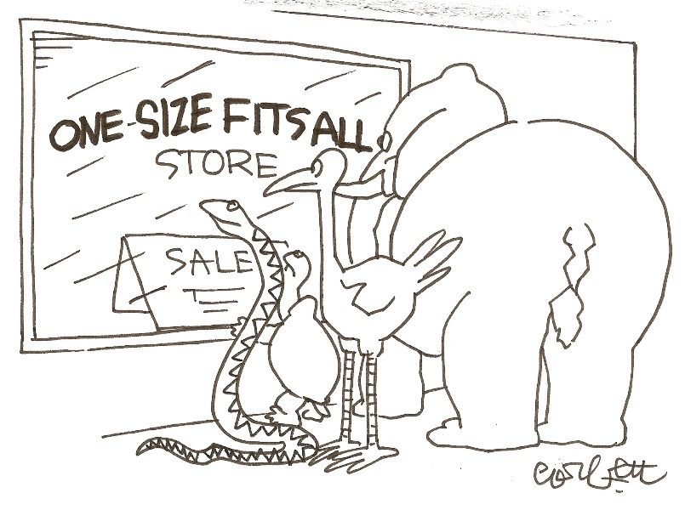
Pro-D Day Friday, February 19th, 2016
ONE SIZE FITS ALL?
Differentiation: Thinking and Learning for the 21st Century

Slide 2
HOUSEKEEPING
SIGN IN
Daily Schedule (on right)
Materials
Extra supplies
Treats
WASHROOMS
EMERGENCY EXIT
Feedback Form completed prior to leaving
BOOK DRAW @ 2:15 Must be in attendance

Slide 3
Life seeks organization, but it uses messes to get there. Organization is a process, not a structure.
Margaret Wheatley

Slide 4
Agenda
http://pamsamaddar.weebly.com
AM 10:30-12:15 | Activate Every Kid Needs a Champion – Rita Pearson | Reflect
 | Acquire What is differentiation? DI “Is” / “Is Not”? Why differentiate? Teacher Mindset Designing /Implementing Learning Experiences Instructional Strategies that Support DI & Engage Students
12:00-12:45 | LUNCH
PM 12:45-2:30 | Apply Entry Points / Partner Talk Personal / Partner Planning Time
 | Reflect Share Out - I like, I Wonder, I have Talking Circle DRAW 2:25
End of Day : Return room to its original state ☺
Notes:
Share the purpose of using the Activate, Acquire, Apply cycle in working with all learners

Slide 5
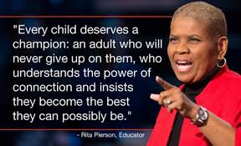
ACTIVATE: Inspiring Ideas Towards Creating Our Own Understanding of Differentiated Instruction
The Late Rita Pierson “Every kid needs a champion”
https://www.youtube.com/watch?v=SFnMTHhKdkw
7:48

Slide 6
Why Are We Here?
“Seeking to ensure that each young person leaves his or her family, community and school prepared to be an independent, self-directed, lifelong learner – a person who will most likely have many careers over a lifetime.”
Anne Davies, MCAW (2007)
Notes:
Building Student Success

Slide 7
Learning Targets
Focus on what is means for a teacher to effectively lead a differentiated classroom
Explore mechanics of managing a differentiated classroom
Keep, as Carol Ann Tomlinson puts forth, ideas as an “aspirational guide”; Ideas you can read and reread in pursuit of understanding and insight around DI
Dig into research of some leaders of DI, Beers, Davies, Doubet, Cash, Heacox, Imbeau, Herbst, Hockett, McTighe, Sousa, Tomlison, Wormeli
Talk about teaching differently and smarter, not harder (Sousa, p.3)
To “Sprinkle” in some personal stories
To experience collaboration & personal time

Slide 8
A 1-Day Workshop?
PATH to DI
A BIT ABOUT ME
Path to DI (Wormeli, Guskey, McTighe, Davies - Quality Assessment, Kagan, Classroom Management, Mentorship, Colleague request & Key Conferences, including ASCD 70th Annual Conference)
Making sense of it all? Interdependence of learning environment, curriculum, assessment, and instruction
It’s all about my students, including candidate teachers – past, present & future!
Experience as a parent!
Wife & Mom
Teacher – 33 years (Secondary, Elementary & Now Middle
KLO Teacher – Band & Humanities; CIA Leader / Former Program Leader
Enjoy music and love ethnic food
Favourite Time: Camping, Exploring BC & My Back Yard

Slide 9
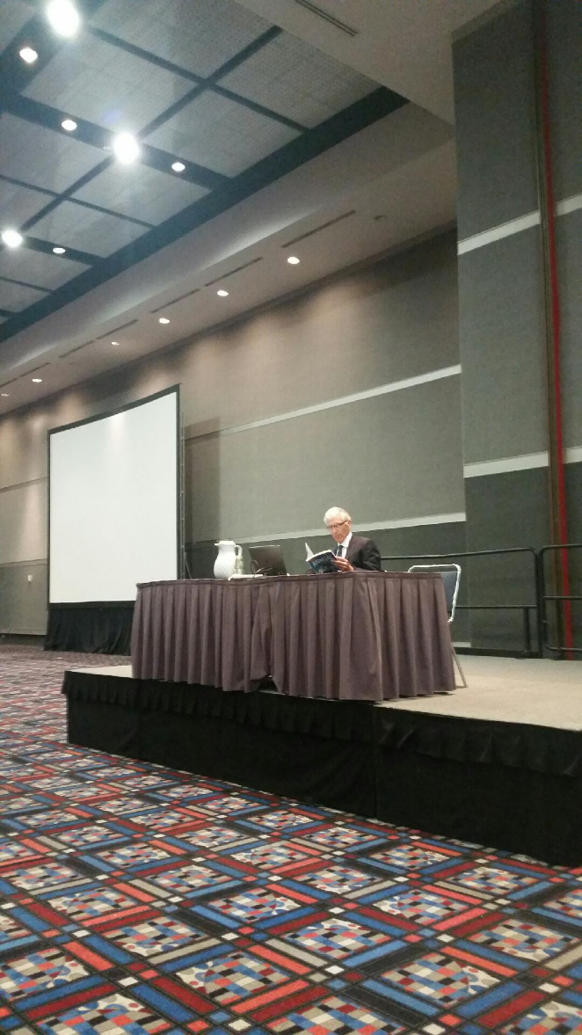
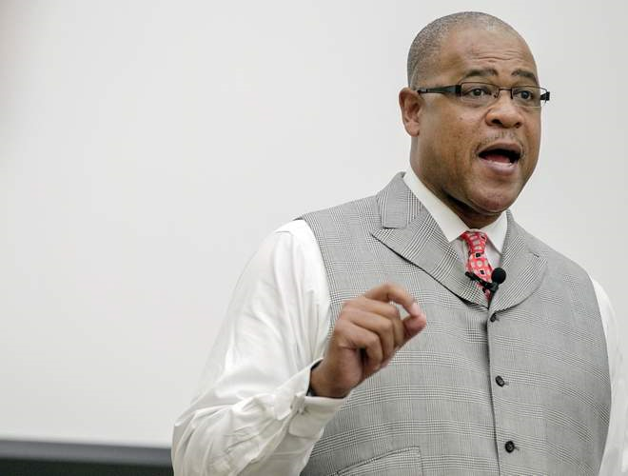
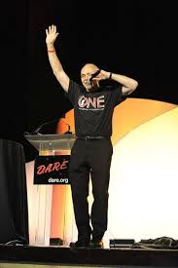
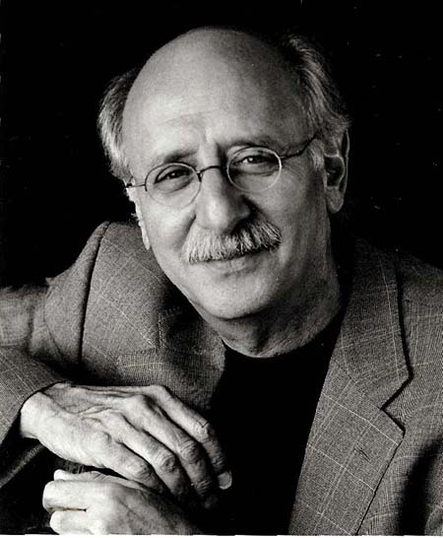
ASCD 70th Annual Conference – Houston, Texas
SPEAKERS* RESOURCES
*INSPIRING! *BIG NAMES

Slide 10
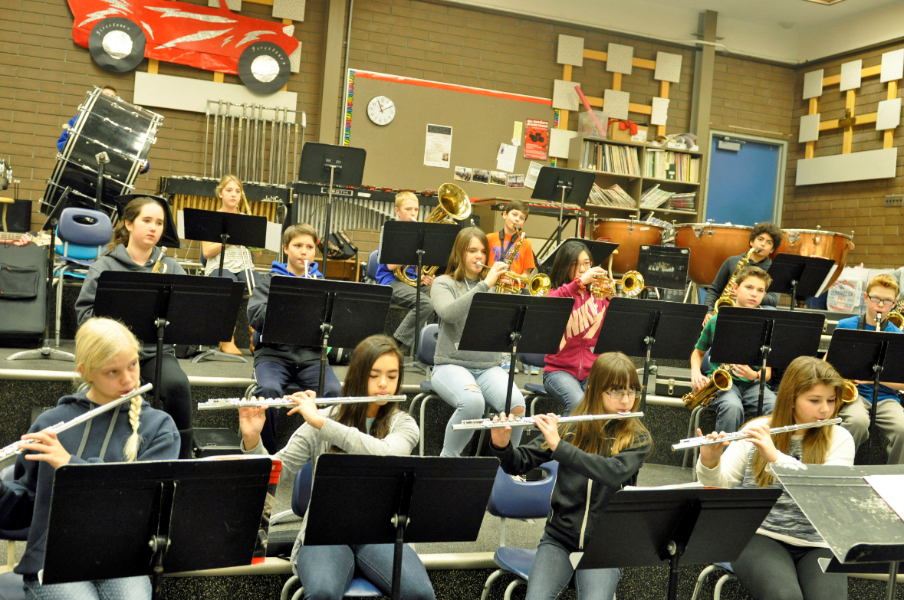
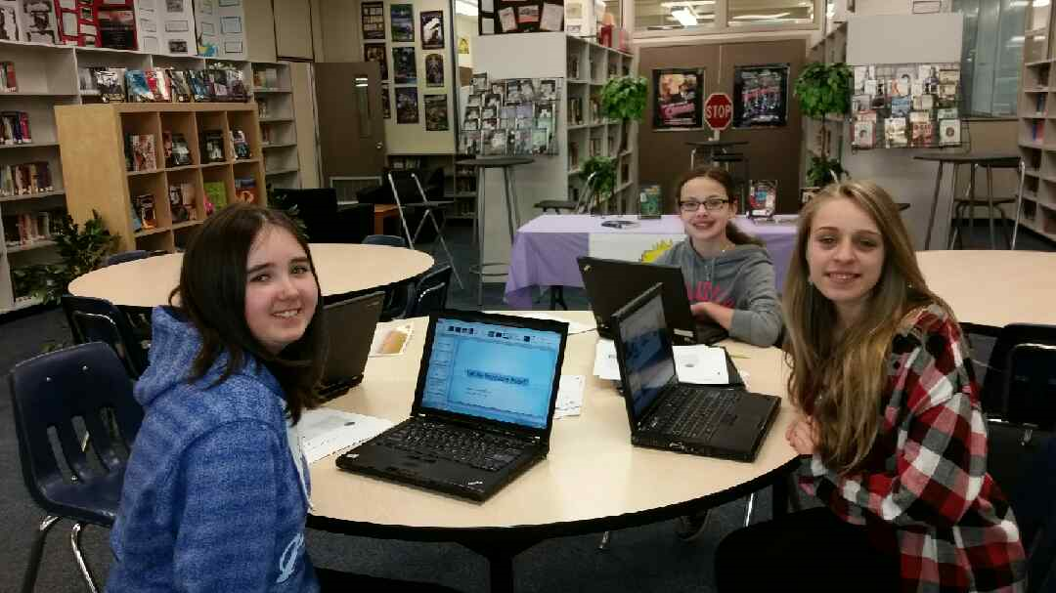
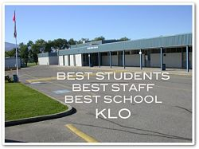
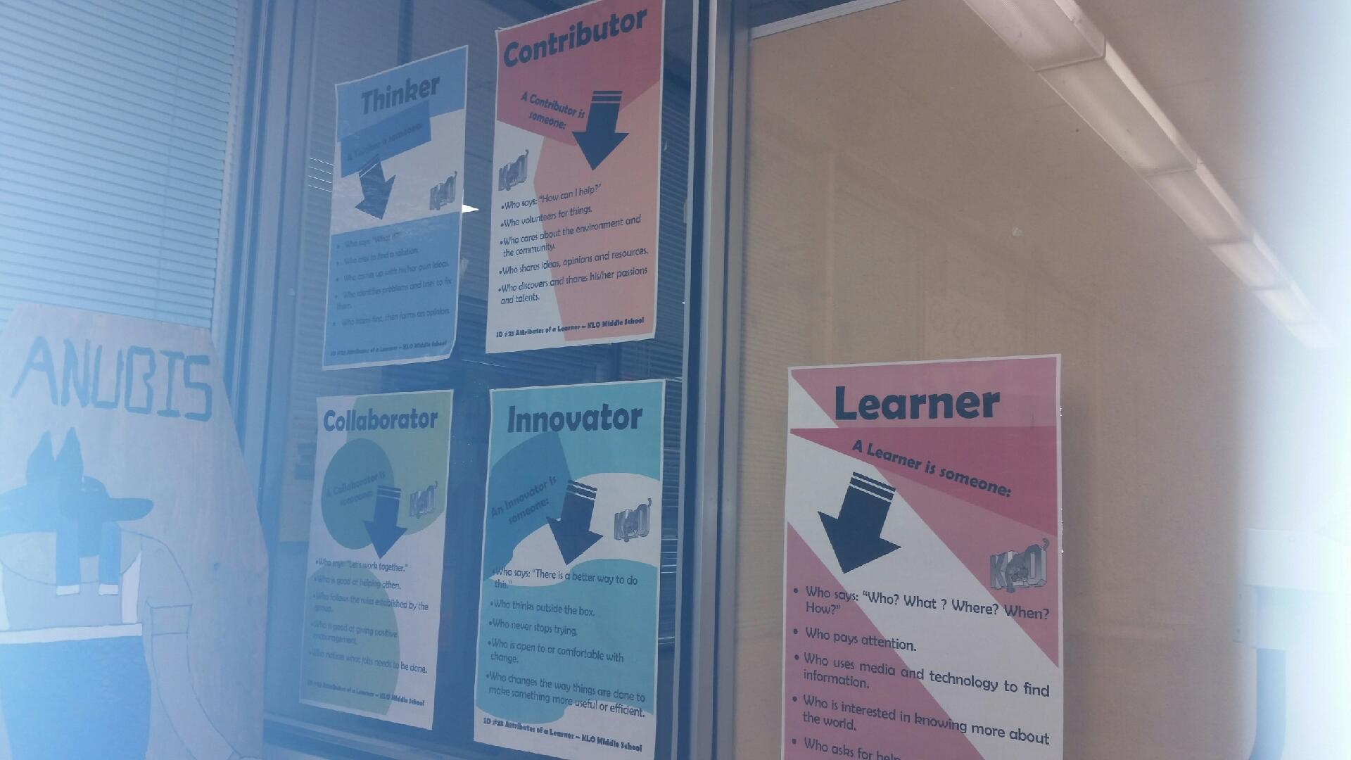
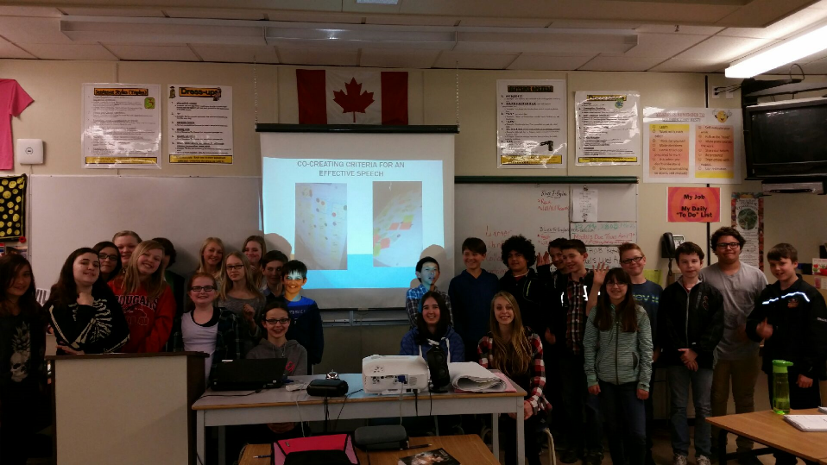
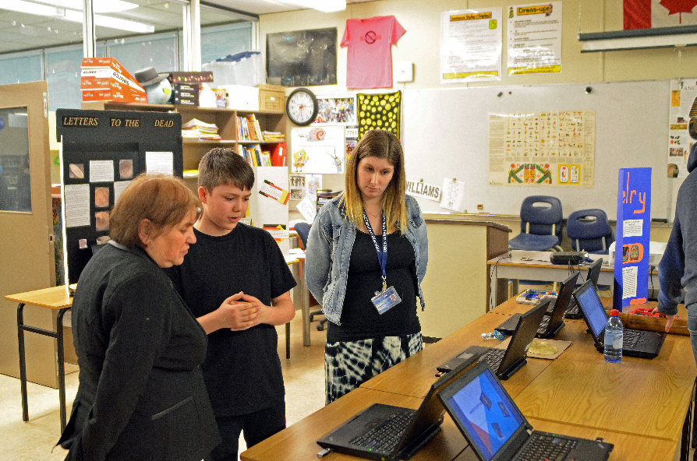

Slide 11
A JOURNEY WITH THE END IN MIND
Reflection is one way to dialogue with yourself about a learning experience.
The purpose of reflection is to help establish what we have learned while studying and applying the strategies that were presented.
Our reflection END OF TODAY could answer questions like the following:
Did I accomplish what I set out to accomplish?
What did I learn that was useful to me as an educator?
How did this learning change my thinking or practice?
What more would I like to learn about the subject?

Slide 12
REFLECT AS WE GO? THROUGHOUT EACH DAY PERSONALIZE
“AHA” MOMENTS What are your take-aways? | CELEBRATIONS Highlight/list what you are proud of in your own practice!
MY CLASS? How might you apply or experiment with an idea/s from today? | FOLLOW-UP / THE FUTURE Are their topics, structures or strategies you would like to explore?

Slide 13
Strategy Harvest – One of My Goals For You, Too! HARVEST STRATEGIES

Slide 14
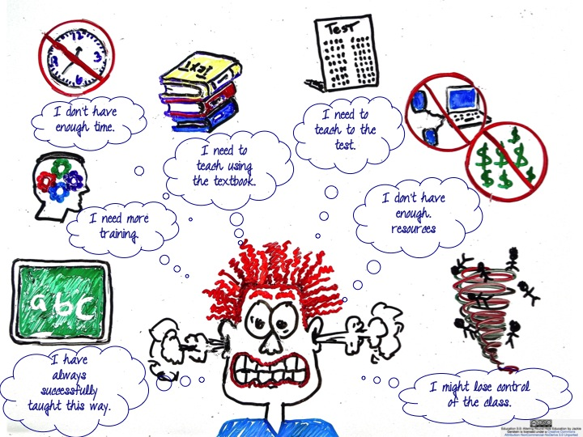

Slide 15
Remember!
There is no single, tried-and-true method of differentiating instruction and assessment for all students. We do whatever works. However, there are some commonly accepted practices that can help teachers design more effective and responsive lessons.
My goal is to guide our journey in helping us grow deeper in our understanding of DI.
Even if you find the subject matter grade levels differ, you may still find strategies to incorporate into your specialty. Pull out the practices which you find helpful!

Slide 16
My hope is to show you DI…
Is a feasible, practical, worthwhile approach that honours classroom diversity
Does not require you to design nine different assignments, orchestrate intricate group tasks, or put on a major production

Slide 17
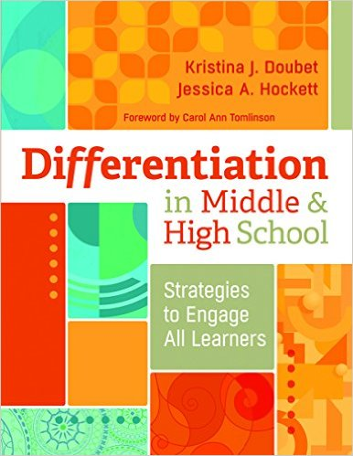
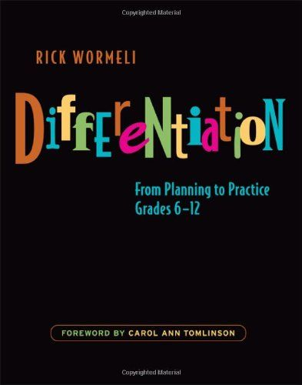
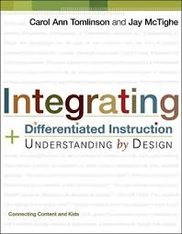
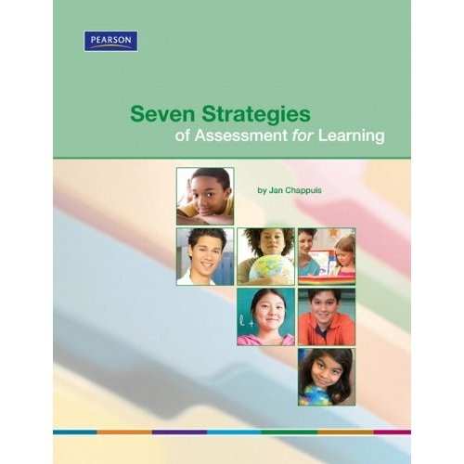
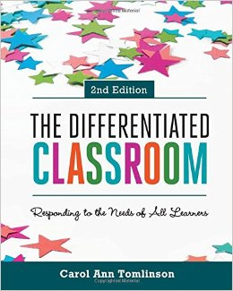
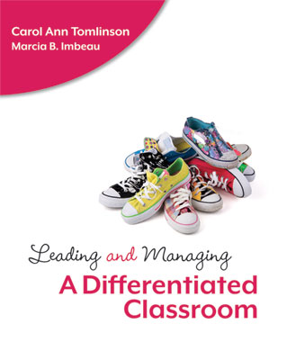
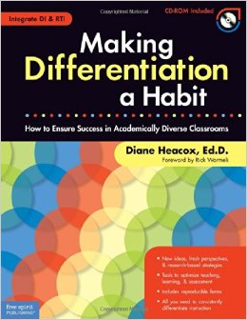
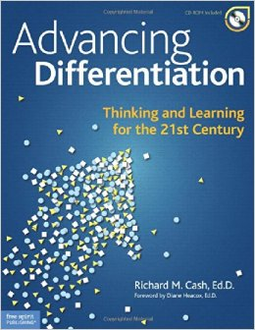
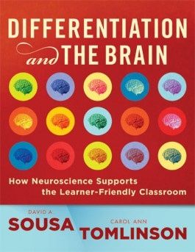

Slide 18
Welcome/Introductions/ Overview / End in Mind What is differentiation? DI “Is” / “Is Not”? Why differentiate?
PART A

Slide 19
PART B
Why DI? Connecting DI & 21st Century Thinking & Learning Positive Aspects of DI / Dispelling Myths Yes, But… Teaching What You Believe Beliefs that point to DI (Traditional vs DI) Importance of Teacher/Student Mindset Traditional vs DI

Slide 20
PART C
How to differentiate? Principles/Key elements of DI What matters most? KUD's Curriculum, Instruction, Assessment Connection Taking Inventory & Browsing Resources

Slide 21
PART D
Collaborative/Personal Planning Time Select a focus for last part of day! 2:15 BOOK DRAW It’s a Wrap!

Slide 22
Let’s Get Started!

Slide 23
INTRODUCTIONS
Who are we & where are we from?
Roles/assignments?
An Interesting Fact?
Something interesting about yourself that you are comfortable sharing?
A highlight of your school year to date?

Slide 24
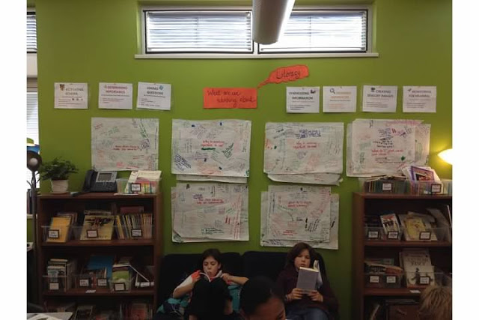
Chalk and Talk: What would you like to take-a-way today?
Partner talk: “What makes you say that?”

Slide 25
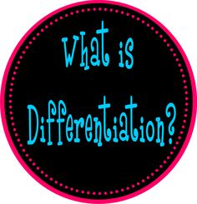
PUTTING DIFFERENTIATION INTO PRACTICE – First?

Slide 26
What Do We Know (Pre-Assessment)
Differentiation
is / is not!

Slide 27
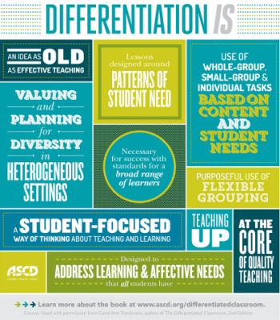
Differentiation – Is / Is Not?

Slide 28
Defining Differentiated Instruction
Is a systematic approach to helping teachers ensure every student is learning.
It’s about meeting students where they are and providing appropriate challenge and support so that each of them can move forward.
We must ensure that the learning environment provides a pathway to success for every learner. (ASCD 2015 Professional Development Sourcebook, p.8)

Slide 30
Differentiation in Middle & High School, Doubet & Hockett (2015)
Differentiation, is in essence, a way of upping the ante in the planning process by calling on teachers to purposefully, and proactively think about how instruction could be more responsive to more kids

Slide 35
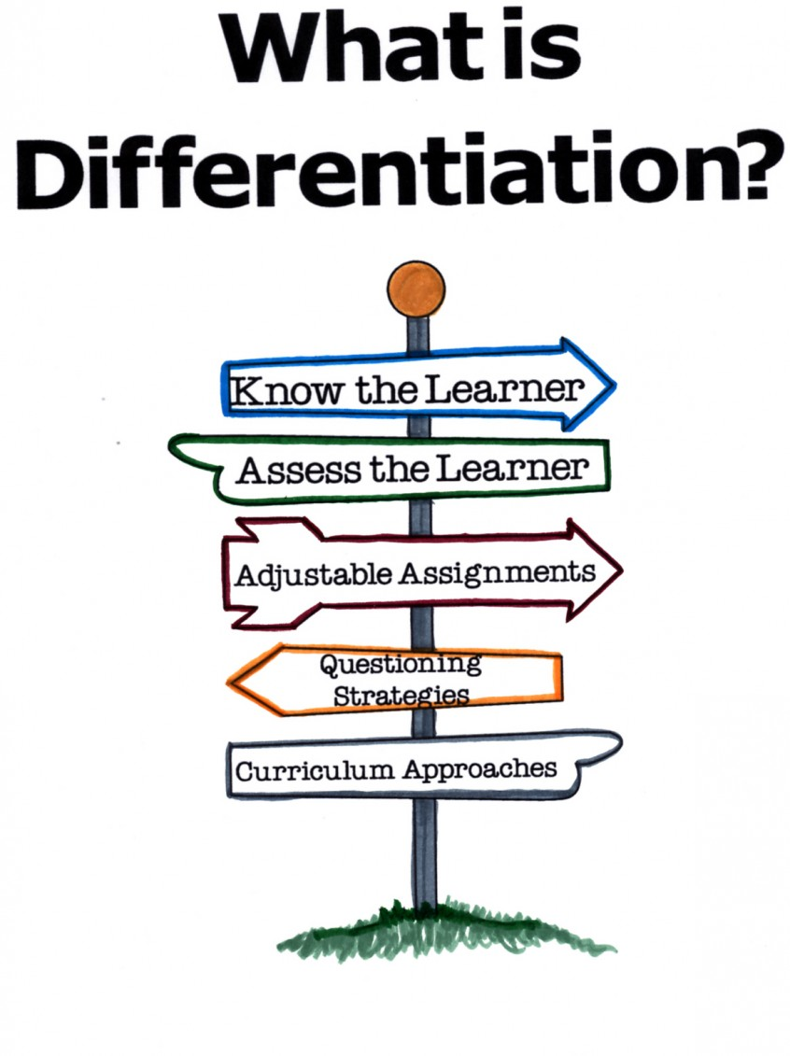

Slide 37
Rick Wormeli Points Out
Differentiation is a derivative of informed assessment and an imperative for effective instruction of students with “special needs” and goes on to remind us that every student has special needs at some time (or many times) in a school day, a school year, and a school life
Differentiation is what we do if we intend to have every student understand what they are learning, why they are learning it, why the should care, and how it makes them more fully human

Slide 38
What is DI (Kagan SmartCard, 2005)
Premise is that students are different
If teachers treat all students the same and teach to the average student, they fail to reach and teach all students
Teachers who acknowledge and respect student differences can diversify their classroom practices to maximize success for each student

Slide 39
Differentiation is…
About moving all students toward and beyond common and important learning goals.
Sometime (but not always) students share a route toward those goals.
Other times (but not always), ongoing assessment compels teachers to plan two or more routes that vary by readiness, interest, or learning preferences (Tomlinson, 2014)

Slide 43
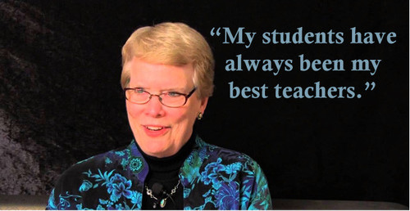
Carol Ann Tomlinson 1:55
An Introduction to Differentiation (Carol Ann Tomlinson) https://www.youtube.com/watch?v=KNkKWjGMerE&list=PLOXUrDMSVPHnDeKVZTOfi2pjWMegTcRCD&index=3

Slide 44
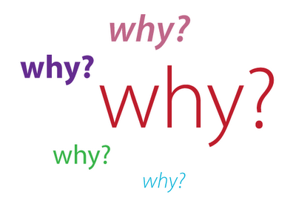
WHY DIFFERENTIATION?

Slide 47
Beliefs That Point to Differentiated Instruction
“Differentiation is making sure that the right students get the right learning tasks at the right time. Once you have a sense of what each student holds as ‘given’ or ‘known’ and what he or she needs in order to learn, differentiation is no longer an option. It is an obvious response” (2003, pp.86-87).
Propels a teacher to look “eyeball to eyeball” at the humanity of each student and dictate classroom practice as a result. “If you believe X, what choice do you have but Y?”
Leading and Managing a Differentiated Classroom, Imbeau & Tomlinson (2010)

Slide 48
Beliefs that Attend to the Needs of Individual Learners
#1: Every student is worthy of dignity and respect
#2: Diversity is both inevitable and positive
#3: The classroom should mirror the kind of society in which we want our students to live and lead
#4: Most students can learn most things that are essential to a given area of study
#5: Each student should have equity of access to excellent learning opportunities
#6: A central goal of teaching is to maximize the capacity of each learner
Leading and Managing a Differentiated Classroom, Imbeau & Tomlinson (2010), p. 27-37

Slide 49
Students Are Different!
Students are unique individuals with unique learning needs
Academic Ability | Multiple Intelligences | Learning Style | Thinking Style | Attitudes
Gender | Culture & Ethnicity | Socioeconomic Culture | Language Differences | Development Readiness
(Kagan SmartCard, 2005)

Slide 51
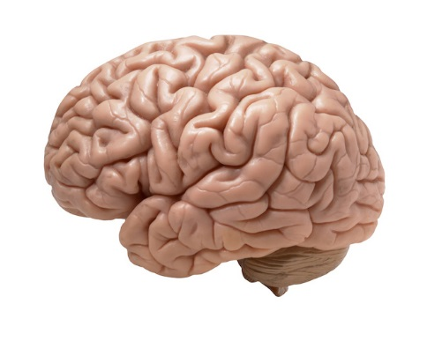
How Neuroscience Supports the Learner-Friendly Classroom
Sousa puts forth in his book Differentiation & the Brain, processes for differentiating curriculum, instruction, and assessment were supported in many ways by what researchers in cognitive psychology and neuroscience were revealing about how the brain learns.
“Differentiation emphasizes shared responsibility between teacher and student, because the brain that does the work is the brain that learns!” (Sousa, p.3)
Differentiation is neither revolutionary nor something extra. It is simply teaching mindfully and with the intent to support the success of each human being for whom we accept professional responsibility.
DIFFERENTIATION IS BRAIN-FRIENDLY & BRAIN-COMPATIBLE

Slide 52
Brain Research Supports Differentiation Sousa/ Tomlinson, 2011, p.13-15
Each brain is uniquely organized. (While similarities/important differences. E.g., individual preferences of how we learn – alone/in groups; listening/observing/participating….” – learning profile. One size fits all is hardly brain-compatible.
Brain is a pattern-making machine. Frontal lobe determines whether incoming information has meaning for the individual. Brain looks for patterns. More apt to retain information that has meaning in long-term memory.
Exploring different ways to solve problems develops divergent thinking. Convergent thinking, on the other hand, generally has a single correct solution.

Slide 53
Brain Research Supports Differentiation, Sousa/ Tomlinson, 2011, p.13-15
Emotions are processed in the brain’s limbic system. Differentiation offers more rewarding learning opportunities. Emotional “aha’s” release chemicals that stimulate the brain and keep students motivated to continue learning.
Differentiation ensures a constructive environment. Learning is as much a social process as a cognitive one. Constructive social interactions generate positive emotions and develop executive functions.
Differentiation can include instructional strategies that are more likely to result in students retaining rather than discarding what they learn. Let’s help them carry information in long-term vs. short-term memory.
Learning for retention requires focus and extended attention. Differentiation can tailor activities to meet individual student needs, thereby maintaining student interest and focus

Slide 54
Marcia Imbeau http://inservice.ascd.org/leading-and-managing-a-differentiated-classroom-an-interview-with-marcia-b-imbeau/
“I believe the need for differentiation is more imperative in some ways than in years past because of the increase in the number of students who come to school “all over the map” in terms of their needs, interests, and learning preferences. We have many more students in U.S. classrooms today who live in poverty, do not speak the language of the classroom, and may have had limited opportunities compared to more advantaged peers. But these students have an enormous potential to thrive under effective teachers who know how to respond to their varying needs.”
Interview by Erin Klein, August 2014

Slide 55
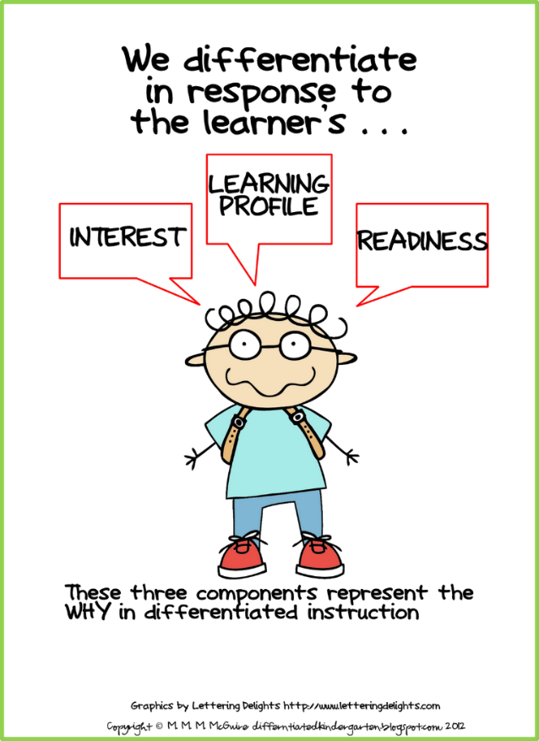
Students Are Much Alike &Very Different
Like all humans, students are looking for a sense of their own meanings, roles, and possibilities
They come to the classroom first looking for things like affirmation, affiliation, accomplishment and autonomy
Integrating Differentiated Instruction & Understanding by Design, Tomlinson & McTighe, 2006

Slide 56
Students Are Much Alike & Very Different
They are looking for adults who accept them, value them, guide them and represent for them what it means to be a competent and caring adult
It is the teachers' job to make the link between the basic human needs of students and curriculum
Integrating Differentiated Instruction & Understanding by Design, Tomlinson & McTighe, 2006

Slide 57
Some Categories of Student Variance – Fig. 2.1 (p. 17)
Category of Student Variance | Contributors to the Category | Some Implications for Learning
Biology | Gender, Neurological "wiring", Abilities, Disabilities, Development | High ability/disability exist in a whole range of endeavours; will learn in different modes, timetables; some parameters for learning are somewhat defined, but are malleable with appropriate context and support
Degree of Privilege | Economic status, Race, Culture, Support system, Language, Experience | Students not in positions of power face greater school challenges Quality of students' adult support system influences learning Breadth/depth of student experience influence learning
Positioning for learning | Adult models, trust, self-concept, motivation, temperament, interpersonal skills | Parents who actively commend education positively affect their children's learning; trust, positive self-concept, positive temperament, and motivation to learn positively impact student learning; positive interpersonal skills and "emotional intelligence" positively impact student learning
Preferences | Interests, Learning preferences, Preferences for individuals | Student interests will vary across topics/subjects; students vary in preference for how to take in and demonstrate knowledge; students will relate to teachers differently
Integrating Differentiated Instruction & Understanding by Design, Tomlinson & McTighe, 2006

Slide 58
Central Okanagan School District Mission Statement & Vision
Our Mission: To educate students in a safe, inspirational learning environment where every student develops the knowledge and skills to be a lifelong learner and a healthy productive member of our global society
Our Vision: Central Okanagan School District is a progressive leader in education which sets the standard for educational excellence and ensures that every student has opportunities to succeed

Slide 59
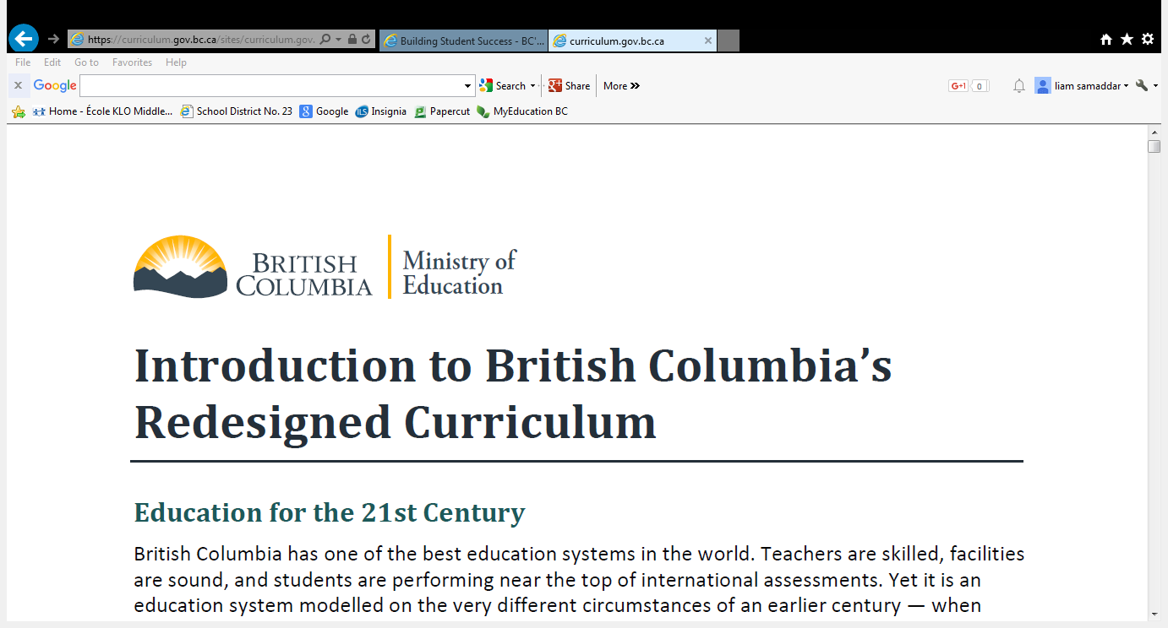
Introduction to BC’s Redesigned Curriculum
Video: (2:22)
https://www.youtube.com/watch?v=lXyyZql2PZQ&list=PLbER4Sxdn0R5di6I8IE7lK_qggeZA_ky3
Less prescriptive and more focused on student competencies

Slide 60
Curriculum Redesign Directions
What are the new directions? | What will stay the same?
Increased flexibility and space for teacher innovation, student passions, and greater depth of study “Big Ideas” for each grade in each area of learning Explicit focus on competencies Support for inquiry, project-based, hands-on, and interdisciplinary approaches Aboriginal perspectives and content authentically integrated into all subjects A common framework for all areas of learning | Rigorous learning standards in each area of learning A strong focus on the foundations of reading, writing and mathematics Subjects such as Math, Science, Language Arts, and Social Studies remain at the heart of every student’s education
September 2015
2

Slide 61
Features of all Redesigned Curriculum
DIRECT LINK
https://curriculum.gov.bc.ca/curriculum/arts-education/

Slide 62
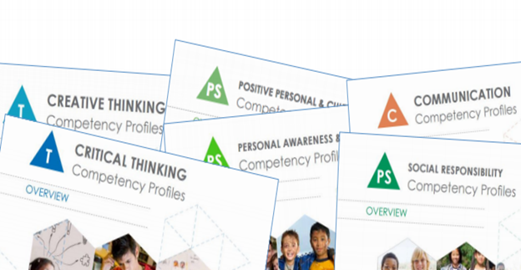
Core Competencies
https://curriculum.gov.bc.ca/competencies
https://www.youtube.com/watch?v=uP4ndQ5ckoY

Slide 63
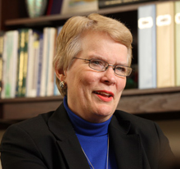
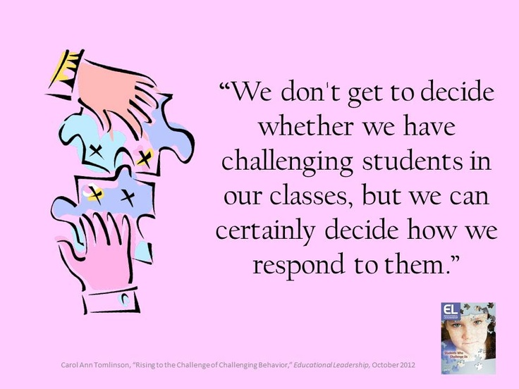
Carol Ann Tomlinson 3:02
Why Differentiated Instruction? Carol Ann Tomlinson
https://www.youtube.com/watch?v=lcQ8shR37yg&list=PLOXUrDMSVPHnDeKVZTOfi2pjWMegTcRCD&index=9

