Slide 1
Team Samaddar Connect-Learn-Grow Week Of: April 20th-24th

Slide 2
Tues., APRIL 21st Grade Leve Meeting
BEGINS HERE!

Slide 3
Learning Intentions Tu., April 21st
HOW DID YOU DO?
We can: Know what to post / turn in – Daily 3 Work Before Zoom Slide 5 Participate in Grade Level Mtg Gr. 5(10:30) & Gr. 6 (22:58) Daily 3 (Before/After Zoom)- Rdg/Wr/Math

Slide 4
CHECKLIST FOR TODAY
Before For Today’s Zoom Meeting
Poetry – 4th video watched (4 boxes now complete w/ point form notes)
HedgeHog’s Home – Be ready to share (See Slide #
Quote of the Day - Matilda
Before/After Zoom Your Daily 3!
Fractions – Working w/ Parts
Simbi or Raz
Journal Entry (2-3 per week) – pick one by Friday
Overdue Work?
Questions? Email

Slide 5
Before Zoom -Hedgehog’s Home Materials: Whiteboard Or Paper
REWATCH/PREP ZOOM GRADE LEVEL MTG
What moral messages are within this film?
List the values portrayed in the film on a piece of paper
Rank in order - most important to least important
HOLD UP YOUR WHITEBOARD OR PAPER DURING OUR GRADE LEVEL MEETING ☺

Slide 6
Quote of the Day Let’s Focus on a Growth Mindset!
“Somewhere inside all of us is the power to change the world.” - Matilda - Roald Dahl
Tell Us @ Zoom Meeting
(1) What the quote means in your own words
(2) How could you apply this quote to yourself (connect to self)
(3) What can the world learn from this quote? (connect to world)

Slide 7
OVERDUE WORK?
Scroll through “Stream” of Google Classroom
“Turn In” using Google Classroom feature
Posts to FreshGrade
a)Math Exit Ticket (Fri)
b)SEL Journal
c)2 Journal Entries (2 weeks ☺)

Slide 8
Set up for Simbi Need for Tomorrow
2. Enter SIMBI AT THIS LINK ☺
https://simbi.io/

Slide 9
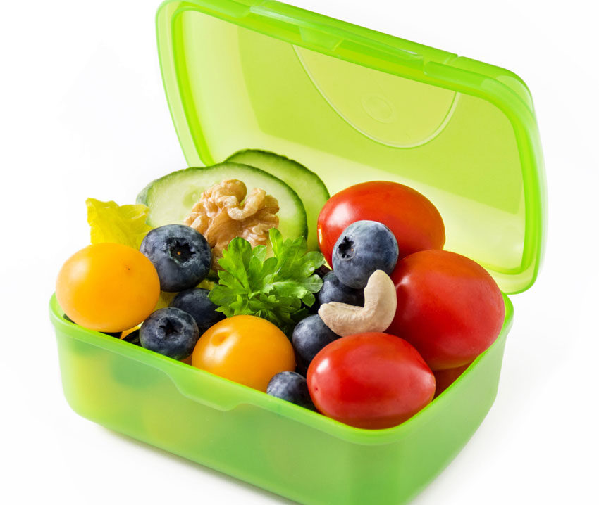
Did you get some nutrition / movement?
CHECK OUT MS. MAY’S MENTAL WELLNESS IDEAS – IN GOOGLE CLASSROOM

Slide 10
Wait for Zoom Meeting Gr. 5 - 10:30 Gr. 6 - 11:58
Join Zoom Meeting https://sd23.zoom.us/j/9012148642 Meeting ID: 901 214 8642

Slide 11
Opportunity to Extend! Mini Inquiry Student Voice/Choice
Go Deeper
Hedgehog stands up for his beliefs.
Discuss the traits of a good leader.
Research to explore and learn about a leader (past and present) and the impact they’ve had on society.
Is there a leader in your community who inspires you?
SHARE DURING FUN FRIDAY ZOOM

Slide 12
Zoom Meetings Focus April 20th-24th
Day | Whole Class | Grade 5 | Grade 6
Monday Mindset Monday + MINI LESSON | 11:58 – 12:40
Tuesday Poetry & Fractions |  | 10:30 – 11:00 | 11:58 – 12:38
Wednesday Wack Wednesday – hat day! | 10:30-11:10 Lunch Invite 11:30 (15 min.)
Thursday Poetry & Fractions |  | 11:58 – 12:38 | 9:50 – 10:30
Friday FUN FRIDAY Mrs. Nunes visit | 8:30 – 9:10 Lunch Invite 11:15 (15 minutes)
Join Zoom Meeting https://sd23.zoom.us/j/9012148642 Meeting ID: 901 214 8642
Mrs. Schultz & Mrs. Boulanger
Additional Zooms for Some of You!
Private Emails/Phone Calls ☺

Slide 13
Stay Connected!

Slide 14
ZOOM Grade Level Meeting Today See You Soon!

