Slide 1
Team Samaddar Connect-Learn-Grow #1 Daily Visual, Week of April 6th-9th

Slide 2
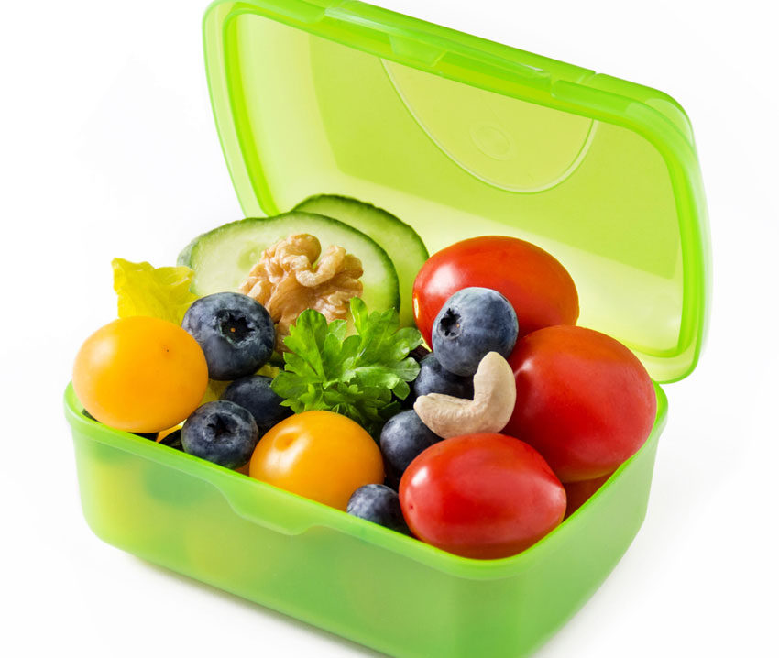
“TO DO’S” BEFORE 11
READ NEXT SLIDE (#4) CAREFULLY
CONTINUE UNTIL IT SAYS “STOP”
SLIDE 12
BUILD IN SNACK & BRAIN BREAK EVENLY BETWEEN 3 TASKS

Slide 3
Welcome Back! Learning Intentions, Monday, April 6th
We can: Start getting organized and set some routines Read our daily visual (PowerPoint) We can complete 3 tasks to prepare for Zoom Meeting - #1 Journal Entry, #2 View Video, #3 Explore Team Samaddar Website Participate in a Zoom meeting and offer feedback tomorrow

Slide 4
On Our Menu Today, Mon., April 6th You may wish to print or handwrite to post as a checklist
Prior to 11:00
A. Get Dressed / Have Breakfast
B. Set Up Routines at Your Home
Set up a quiet space to work
Gather/organize all needed materials
C. Read daily visual to know your day
Complete TASKS #1, #2, #3 before 11
build in healthy snack and brain break
11:00 Lunch

Slide 5
Task #1 Journal Writing/Think Like a Writer 1. Start a new journal - a book or create an ongoing “diary-styled” Google Doc Remember to include April 6th as your date
2. Select one topic from below for today.
What are you excited or worried about?
Write a letter to yourself 10 years in the future. What do you want to tell your future self?
How do you think the world will be different after the novel corona virus?
Write a funny or exciting adventure story about what happens when school is closed.

Slide 6
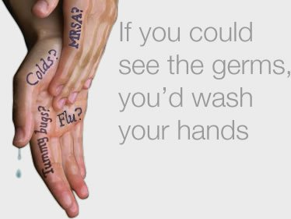
Task #2 – Our New Reality
Watch video this video recommended by Mrs.Nunes. Be prepared to share your take-aways during our Zoom Meeting. Enter this link and see where it takes you!
https://youtu.be/I5-dI74zxPg
Jot your thoughts on a small piece of paper (size of post it note) about what you see, think and wonder.
Save this paper to tape/glue into your thoughtbook when you get it back.

Slide 7
What are you going to do for your brain break today? Did you have a healthy snack?

Slide 8
Task #3 – Check Out Our Team Samaddar Website http://pamsamaddar.weebly.com
Be prepared to share 3 things you notice on our website during Zoom.
You may wish to jot your ideas on a slip of paper and keep it for your thoughtbook.

Slide 9
What’s Up Today, Monday April 6th Consider re-viewing Zoom instructions We will go over features of zoom together
11:45 Start to get ready for Zoom Meeting.
Are all 3 tasks complete?
Log on 10 minutes early so you are not rushed.
Go to link sent to you in Google Docs.
Meeting begins at exactly 12 Noon
Zoom Meeting Begins 12:00 Noon
Ends About 12:30 p.m.
Know I Have to Admit You from Waiting Room

Slide 10
Have Some Time Before Lunch? Consider re-viewing Zoom instructions
11:45 Begin to get ready for Zoom Meeting.
Are all 3 tasks complete?
Log on 10 minutes early so you are not rushed.
Go to link sent to you in Google Docs.
Meeting begins at exactly 12 Noon
Zoom Meeting Begins 12:00 Noon
Ends About 12:30 p.m.
Know I Have to Admit You from Waiting Room

Slide 11
Remember to log on to Zoom at 11:50! Wait for me to let you in from the waiting room ☺

Slide 13
Log On and Wait for Zoom Meeting. My computer will display slideshow once we start!

Slide 14
Welcme & Check In – How Are We Feeling?

Slide 15
Keep in Mind While We Participate in Our 1st Zoom Meeting
How might this way of communicating help us with our learning?
How might this way of communicating help us support one another?
What different ways can you see us using Zoom?

Slide 16
Remember…
What makes us such an amazing class!

Slide 17
What are some things we might consider to organize ourselves at home each day to move our learning forward and to help each of us cope with our new reality?
Share during Zoom

Slide 18
Let’s Have Some Fun!
Look & Find
I Spy

Slide 19
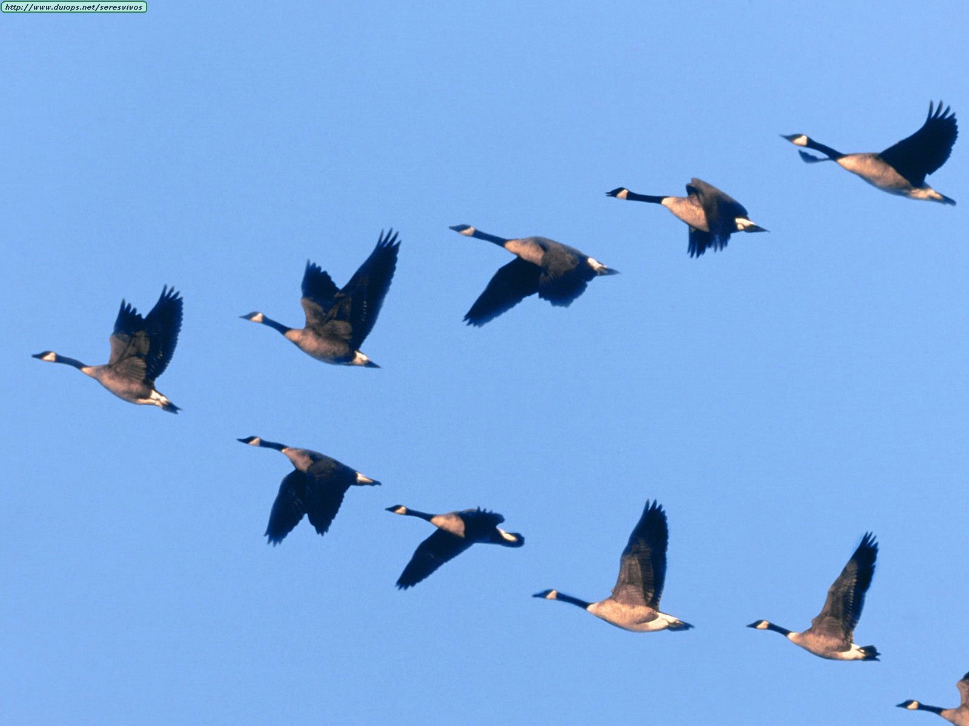
As a class, what do we believe is important?

Slide 20
Creating a Safe & Comfortable Place to Learn & Grow

Slide 21
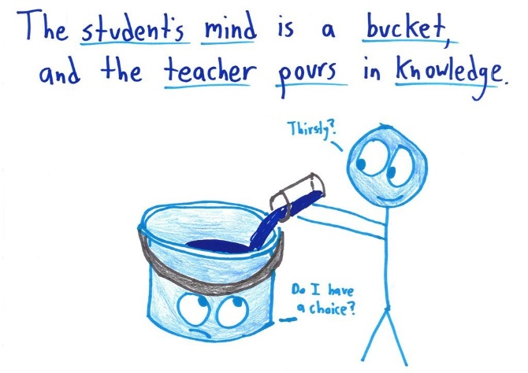

Slide 22
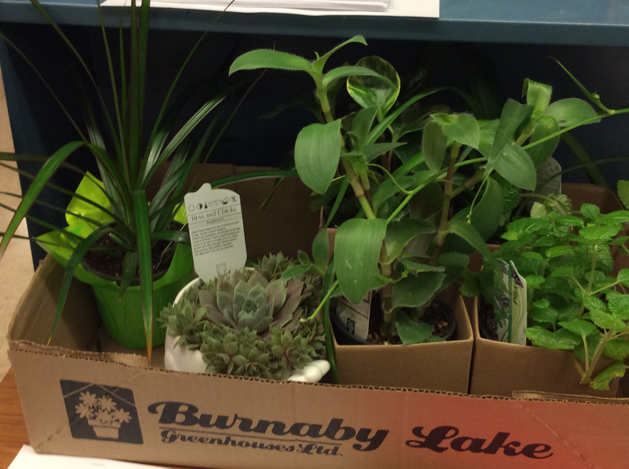
Remember? Arboretum Activity
What would success be for your plant?
How would you care for your plant so it can be successful?
What do we learn from plants of how we might ensure success for each other?
“Everybody is a genius, but if you judge a fish by its ability to climb a tree, it will live its whole life believing it is stupid.”
- Albert Einstein

Slide 24
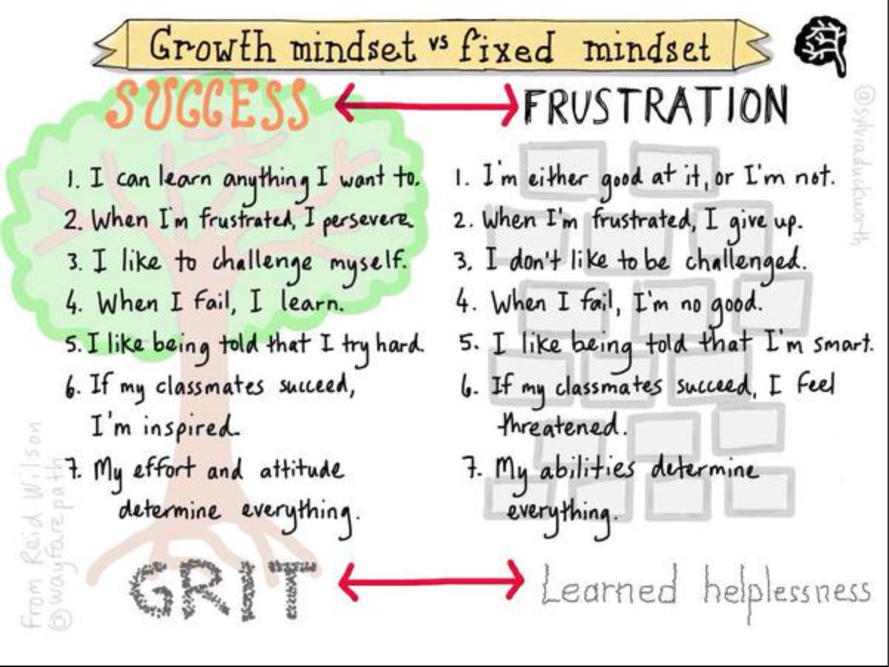
Notes:
Paradigm shift from a fixed mindset to a growth mindset.

Slide 25
Notes:
FNESC’s First Peoples Principles of Learning will be woven in the new curriculum.

Slide 26
Notes:
Many of the Principles of Learning lend themselves readily to learning Core French and additional languages

Slide 27
Notes:
First Peoples Principles of Learning continued.

Slide 28
My Job/ Your Job
Learn
Work with others
Think for myself
Make decision
Come to school prepared to work
Ask when I don’t understand
Give teacher something to assess/evaluate
Self evaluate
Follow our class guidelines
Make plans and do the work
Share our beliefs (about how we do things in our classroom)
Be prepared (e.g., homework supplies)
Treat others with respect
Use/participate in restitution process (positive problem solving

Slide 29
How might our learning look…
The Same
Different

Slide 30
How might we support each other to be successful with our new way of doing things?

Slide 31
DAILY ROUTINES WILL…
Help grow our independence
Continue our goals to be a classroom with highly engaged readers, writers, and learners
Provide us a way to structure and use our time well in order that we try to meet everyone’s needs – learning and social emotional
We can use our routines to meet our learning intentions

Slide 32
Literacy Weekly 5
Read
Read to Self
Writing
Work on Writing
Read
Read to Someone
Words
Word Work
Listen
Listen to Reading

Slide 33
Numeracy Weekly 3
Math Writing
Math with Someone
Math by Myself

Slide 34
Socials Studies
Science

Slide 35
To Be Continued…Stay Tuned Tomorrow 9:00 ish ☺

