Slide 2
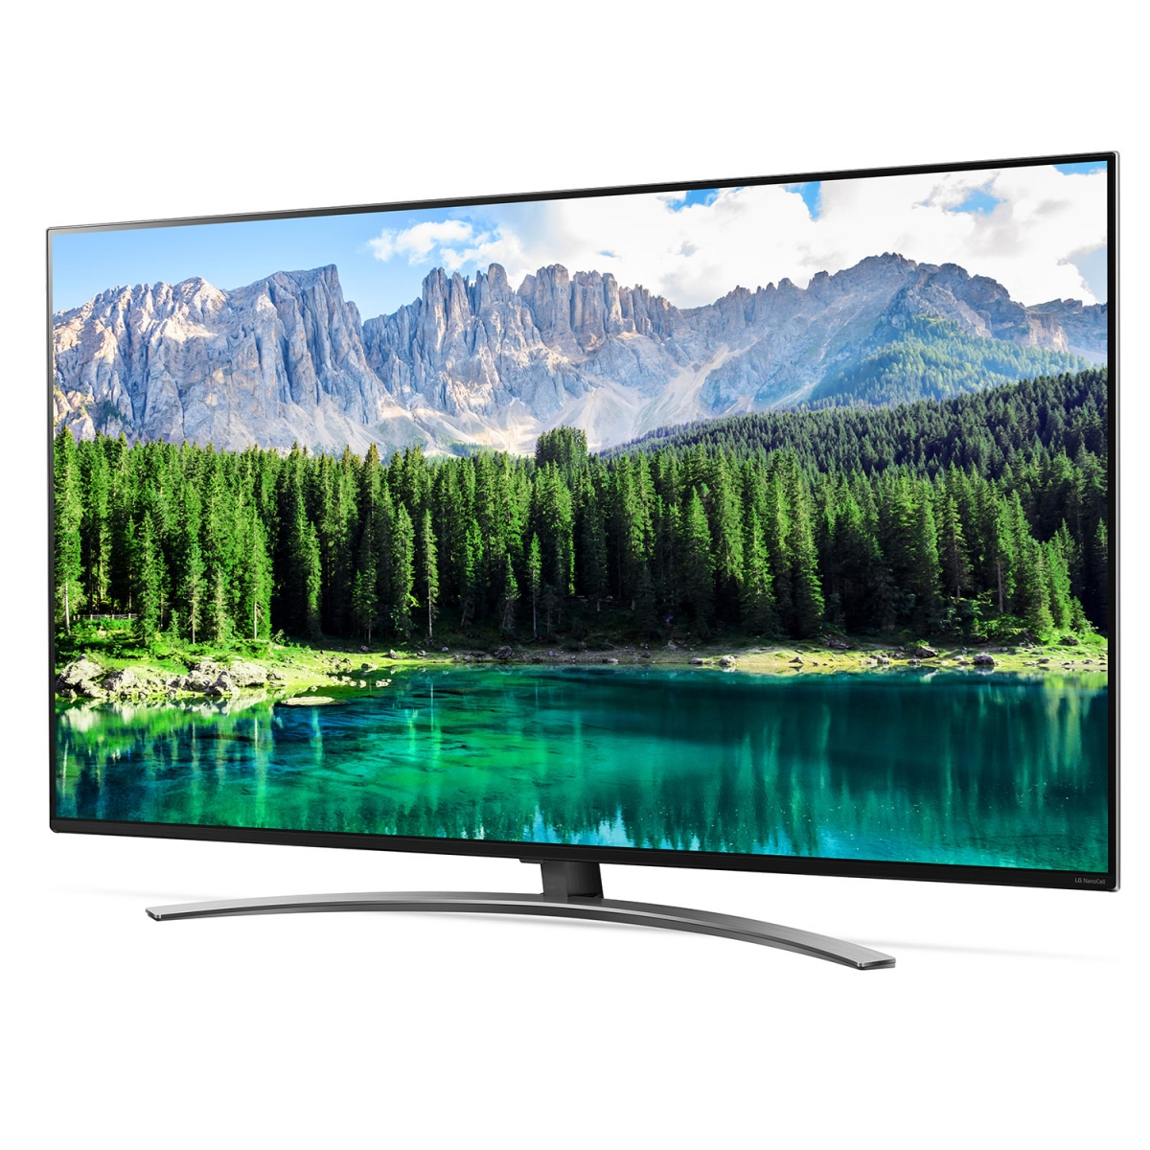
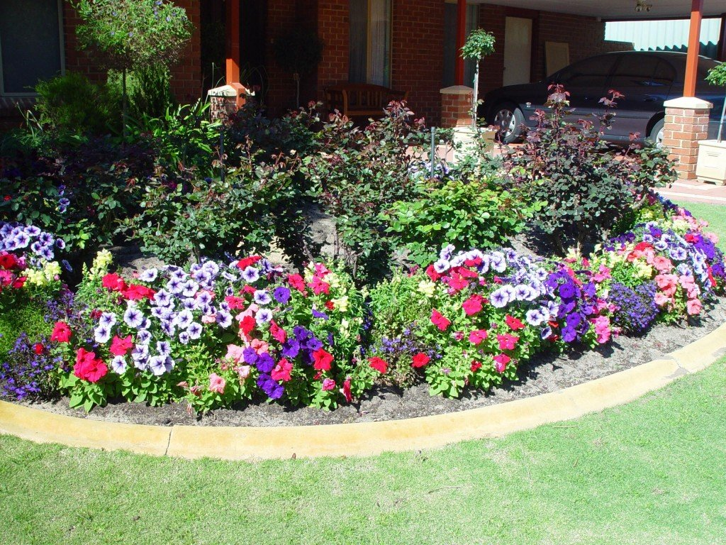
It’ Earth Day - 4 CHOICES “Would You Rather….
GIVE UP YOUR
TV
OR
GIVE UP YOUR FAMILY CAR
SORT RECYCLING
OR
PLANT A FLOWER GARDEN?

Slide 3
Learning Intentions Wed., April 22nd – Earth Day!
WACKY WEDNESDAY – TOO! WEAR A HAT TO ZOOM TODAY!
We can: Complete work to prep for Zoom Meeting 10:30 – Slides Own Our Learning Complete our DAILY 3’S! – Simbi, Journal + New Math Lesson (Fractions Are Division) Check for overdue work Have accounts with all sites needed (Simbi, IXL or Khan) Find a “wacky” hat for Wacky Wed! Optional – Attend Lunch Zoom 11:30

Slide 4
Zoom Meetings Wed - Friday
Day | Whole Class | Grade 5 | Grade 6
Wednesday Wack Wednesday – hat day! | 10:30-11:10 Lunch Invite 11:30 (15 min.)
Thursday Poetry & Fractions |  | 11:58 – 12:38 | 9:50 – 10:30
Friday FUN FRIDAY | 8:30 – 9:10 Lunch Invite 11:15 (15 minutes)
Join Zoom Meeting https://sd23.zoom.us/j/9012148642 Meeting ID: 901 214 8642
Mrs. Schultz & Mrs. Boulanger - Additional Zooms for Some of You!
Private Emails/Phone Calls ☺

Slide 5
BEFORE ZOOM MTG!
In Google Classroom Folder For This Week & Posted on Website - Class Videos – button links to I See, I Think, I Wonder Chart
For Today’s Zoom Meeting
1. Poetry – Chart w/ 4 boxes of notes – posted to Freshgrade
2. New! Quote of the Day – be ready to share!
3. Earth Day - I See, I Think, I Wonder
(optional – extra video – NASA) – See Slide #
WACKY WEDNESDAY – TOO! WEAR A HAT TO ZOOM TODAY!

Slide 6
Pre-Zoom Task #1 – 4 Boxes Video Notes Complete & Posted in FreshGrade

Slide 7
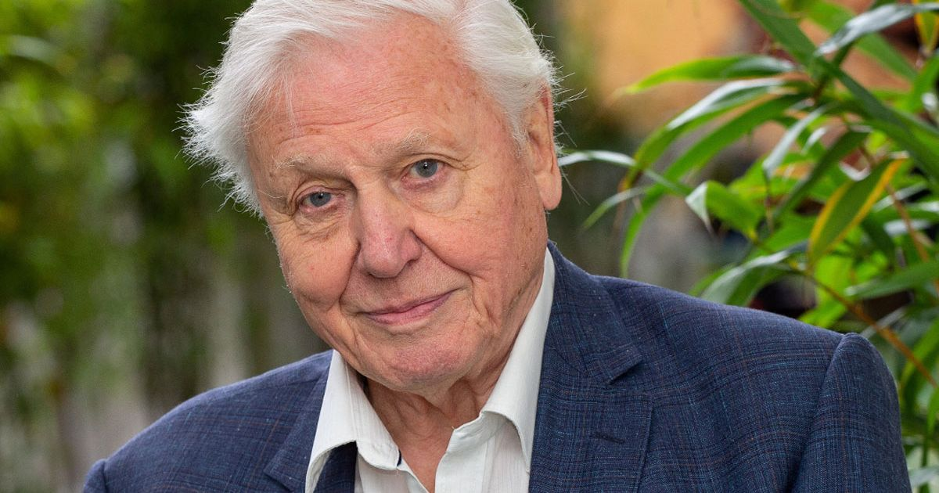
Pre-Zoom Task #2 – Quote of the Day Next Slide
I can reflect on David Attenborough’s quote and be prepared to share an idea at our whole class Zoom meeting

Slide 8
Quote of the Day for Earth Day! Let’s Focus on a Growth Mindset!
“It seems to me that the natural world is the greatest source of excitement; the greatest source of visual beauty; the greatest source of intellectual interest. It is the greatest source of so much in life that makes life worth living.” —David Attenborough
Tell Us @ Zoom Meeting
(1) What the quote means in your own words
(2) How could you apply this quote to yourself (connect to self)
(3) What can the world learn from this quote? (connect to world)

Slide 9
Pre-Zoom Task #3 Earth Day Make My Thinking Visible Activity - Video links (Slide 10)
1. Locate Earth Day video on Team Samaddar Website
2. Make or download “I See, I Hear, I Think” organizer
View video, PAUSE OFTEN. Jot your thoughts - What do you see? What do you hear? What do you think?
Share @ Zoom Meeting
Post to FreshGrade in “Learning from Home Bin”
1 = little to no thinking
2 = Some thinking
3 = The right amount of thinking
4 = Extending (NASA video) – add to your chart from above.

Slide 10
Task #3 – EARTH DAY VIDEO – I SEE, I THINK, I WONDER https://www.youtube.com/watch?v=7I0sFyDKKBA (EXTENDING – NASA VIDEO ADDED) https://www.youtube.com/watch?v=d815wa7aIMs

Slide 11
OTHER: LAST WEEK’S WORK? ALL IN?
Scroll through “Stream” of Google Classroom
“Turn In” using Google Classroom feature
Posts to FreshGrade
a)Math Exit Ticket (Fri)
b)SEL Journal
c)2 Journal Entries (2 weeks ☺)

Slide 12
Set up for Simbi Need for Tomorrow
2. Enter SIMBI AT THIS LINK ☺
https://simbi.io/

Slide 13
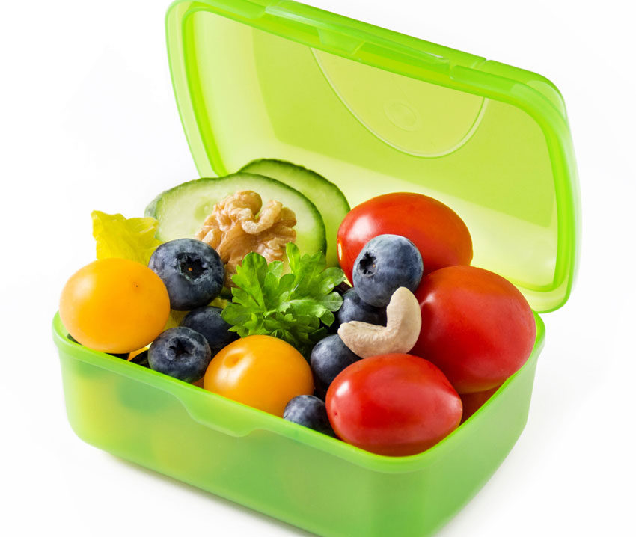
Did you get some nutrition / movement?
CHECK OUT MS. MAY’S MENTAL WELLNESS IDEAS – IN GOOGLE CLASSROOM
NEW - DID YOU SEE MR. FAFARD’S SUGGESTIONS ON FRESHGRADE?

Slide 14
Wait for Zoom Meeting WACKY WEDNESDAY - GRAB A HAT TO ZOOM TODAY!
10:30-11:10 Whole Class
Lunch Invite 11:30 (15 min.)
Join Zoom Meeting https://sd23.zoom.us/j/9012148642 Meeting ID: 901 214 8642

