Slide 1
Team Samaddar Connect-Learn-Grow Week Of: April 20th-24th

Slide 2
MON., APRIL 20TH
BEGINS HERE!

Slide 3
Our Zoom Meetings This Week April 20th-24th
Day | Whole Class | Grade 5 | Grade 6
Monday | 11:58 – 12:40
Tuesday |  | 10:30 – 11:00 | 11:58 – 12:38
Wednesday | 10:30-11:10 Lunch Invite 11:30 (15 min.)
Thursday |  | 11:58 – 12:38 | 9:50 – 10:30
Friday | 8:30 – 9:10 Lunch Invite 11:15 (15 minutes)
Join Zoom Meeting https://sd23.zoom.us/j/9012148642 Meeting ID: 901 214 8642
Mrs. Schultz & Mrs. Boulanger - Additional Zooms for Some of You!
Private Emails/Phone Calls ☺

Slide 4
Learning Intentions Mon., April 20th
HOW DID YOU DO?
We can: Own Our Learning Complete today’s tasks Complete overdue work Access all sites Attend Zoom Meeting 12:00

Slide 5
CHECKLIST FOR TODAY
In Google Classroom Folder & Posted on Website
For Today’s Zoom Meeting
Poetry – 3 videos watched (3 boxes of point form notes complete)
New! Quote of the Day

Slide 6
LAST WEEK’S WORK? ALL IN?
Scroll through “Stream” of Google Classroom
“Turn In” using Google Classroom feature
Posts to FreshGrade
a)Math Exit Ticket (Fri)
b)SEL Journal
c)2 Journal Entries (2 weeks ☺)

Slide 7
Set up for Simbi Need for Tomorrow
2. Enter SIMBI AT THIS LINK ☺
https://simbi.io/

Slide 8
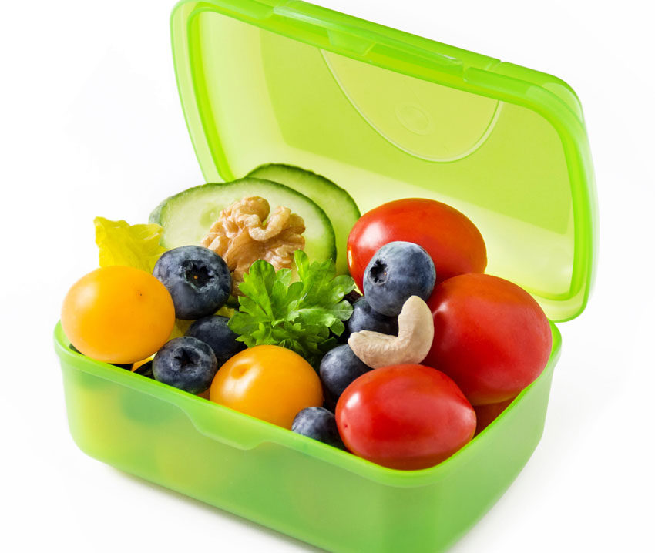
Did you get some nutrition / movement?
CHECK OUT MS. MAY’S MENTAL WELLNESS IDEAS – IN GOOGLE CLASSROOM

Slide 9
Did you get some nutrition / movement?
NEXT WEEK?
CHECK OUT MS. MAY’S MENTAL WELLNESS IDEAS – IN GOOGLE CLASSROOM

Slide 10
Quote of the Day Let’s Focus on a Growth!
“Promise me you’ll always remember: you’re braver than you believe, and stronger than you seem, and smarter than you think.” - Winne the Pooh - A.A. Milne
Tell Us @ Zoom Meeting
(1) What the quote means in your own words
(2) How could you apply this quote to yourself (connect to self)
(3) What can the world learn from this quote? (connect to world)

Slide 11
Wait for Zoom Meeting 12:00 – Excited to See You All!
Join Zoom Meeting https://sd23.zoom.us/j/9012148642 Meeting ID: 901 214 8642

