Slide 1
DAILY 3 Before/After Grade Level Zoom Gr. 6 - 9:50 am Gr. 5 - 11:58 am
Reading
Simbi
Poetry – Notes for 4 Boxes
Writing – How is journal writing going? 1 to post tomorrow?
Math – Fractions Are Division Day 2
Earth Day Activity – I See I Think I Wonder
Overdue Work from Last Week?
Extend? Optional: Mini Inquiry - A Leader &/or Planet Earth & NASA I See I Think I Wonder

Slide 2
MRS. S! ☺
SEE YOU SOON AT YOUR GRADE LEVEL ZOOM MEETING!

Slide 3
Grade Level Meeting

Slide 4
Learning Intentions Together, we can:
Review Routines – Revise? Own Our Learning Check in on our DAILY 3’S! Go Deeper w/ Hedgehog’s Home Talk About How to Read Poetry Intro “Gratitude” 30-Day Challenge” Set Up for Friday 8:30 Zoom w/ Mrs. Nunes! READY TO ROCK…..

Slide 5
Quote of the Day Let’s Focus on a Growth Mindset !
“Alice:
“This is impossible!”
The Mad Hatter:
“Only if you believe it is.””
- Alice in Wonderland - Lewis Carrol
Tell Us @ Zoom Meeting
(1) What the quote means in your own words
(2) How could you apply this quote to yourself (connect to self)
(3) What can the world learn from this quote? (connect to world)

Slide 6
Routine Review Practice Core Competencies (Life Skills/Work Habits)
First Thing Each AM - Check Google Classroom Zoom Meeting Schedule, Daily Visual, All Docs
Know your DAILY 3! Reading/Writing/Math
Other?
Independent Math (IXL OR KHAN) – post 1x/week
D.E.A.R.
Keep well-rested (e.g., a “REGULAR” schedule will help you best your best self

Slide 7
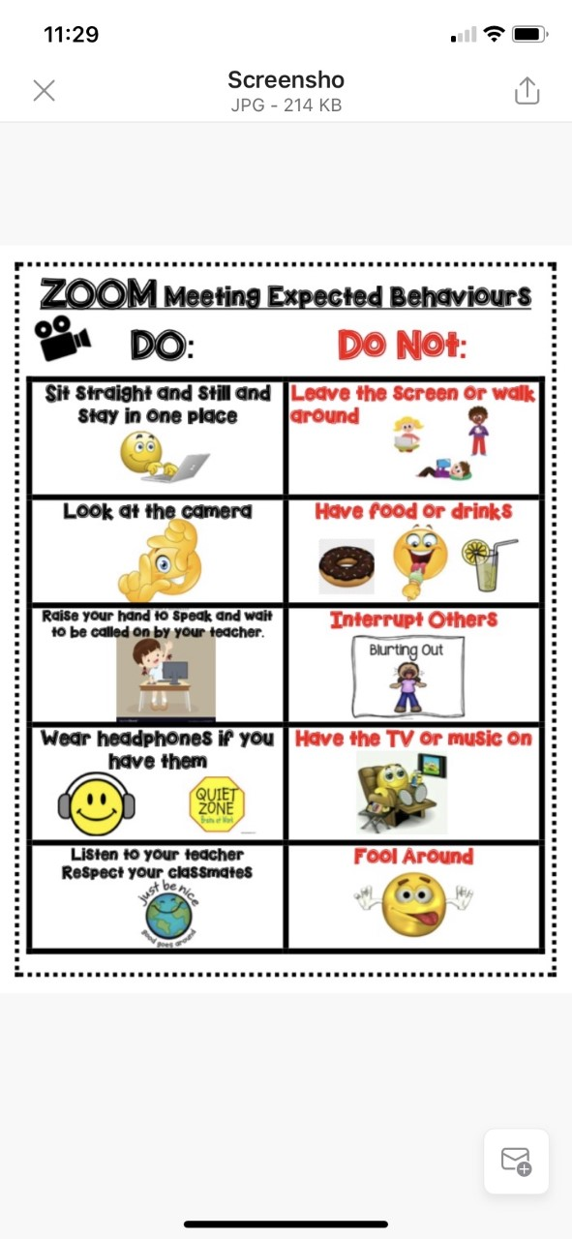
OUR “PLEASE” DO NOTS
Leave
Drink unhealthy drinks – water is best –keep it away from device
Interrupt Others – Use “Chat”appropriately
Be Distracted (e.g., TV, Music, Cooking, Pets)
Lay on a bed
Make weird noises, mess with backgrounds, use your phone, play video games, prank your teacher? ☺

Slide 8
My Job/ Your Job - Learning from Home! We ARE A CARING TEAM!
Learn
Work with others
Think for myself
Make decisions
Come each day at home prepared to work
Ask when I don’t understand
Give teacher something to assess/evaluate
Self evaluate
Follow our class guidelines
Make plans and do the work
Share our beliefs (about how we do things in our classroom)
Be prepared (e.g., homework supplies)
Treat others with respect
Use/participate in restitution process (positive problem solving

Slide 9
SCHOOL WORK IN?
1. Simbi 3/week? 2. 2-3 Journal /wk – post 1 3. SEL Journal 4. Math – 2 lessons – post all to FG 5. Last Week Exit Ticket in FG? 6. Poetry – Preassessment I & II + Notes 4 Videos 7. Earth Day – I See, I Think, I Wonder…uploaded to FreshGrade
Extend: NASA notes w/ Earth Day I See I Think I Wonder Mini Inquiry about a leader who made a difference

Slide 10
Hedgehog's Home Exploring Home and Relationships
2017|10 min
Winner of over 35 international awards,
Hedgehog's Home is an animated film by Eva Cvijanović.
Based on the classic story by Branko Ćopić, a writer from the former Yugoslavia
A universal tale that reminds us there truly is no place like home.

Slide 11
Hedgehog’s Home: Exploring Home and Relationships Theme: Values
Keywords/Topics: Empowerment, peer pressure, bullying, security, friendships, virtues, independence, poetry, homes, values
https://blog.nfb.ca/blog/2018/12/11/mini-lesson-hedgehogs-home/

Slide 12
Go Deeper w/ Guiding Question: How do values shape our beliefs, and how do they change over time?

Slide 13
THINKING LIKE A READER – GOING DEEPER Discuss the clip (46s) https://www.nfb.ca/m/playlists/6d4acd87f83d4d8faad0bdedce41631b/playback/#3
What does Hedgehog value about his home? Can you relate to his monologue?
Answer “Why is your home important to you?” Collaborate to complete a list (We will share Gr. 5 / Gr. 6 lists tomorrow!)
Which classmate mentioned the proverb “Home is where the heart is.”
Next Steps – Fri- Tu (Friday’s Reading Lesson ☺)
Interview 3 people. Discuss their responses to the question “What makes a house a home”?
Draw a picture of your home or a special place within your home and create a proverb or idiom to represent that space.

Slide 14
Opportunity to Extend! Mini Inquiry Student Voice/Choice
Go Deeper
Hedgehog stands up for his beliefs.
Discuss the traits of a good leader.
Research to explore and learn about a leader (past and present) and the impact they’ve had on society.
Is there a leader in your community who inspires you?
SHARE DURING FUN FRIDAY ZOOM

Slide 15
Next? How Does a Person Read Poetry? THINK LIKE AN EFFECTIVE READER!

Slide 16
Poetry Next 3 Days!
C. LOG AND STAR YOUR FAVOURITE 3-5
FORMAT: (Diary Style Chart)
*See doc in Google Classroom Poetry Folder & On Website
*Fill in each column – 1 line per poem
A. READ AS MANY POEMS AS YOU CAN USING LINKS OR EXPLORE GOOGLE!
B. READ USING EFFECTIVE STRATEGIES FOR READING POEMS.

Slide 17
Pre-Zoom Task #3 Earth Day Make My Thinking Visible Activity - Let’s Watch “Planet Earth” Video
1. Locate Earth Day video on Team Samaddar Website
2. Make or download “I See, I Hear, I Think” organizer
View video, PAUSE OFTEN. Jot your thoughts - What do you see? What do you hear? What do you think?
Share @ Zoom Meeting
Post to FreshGrade in “Learning from Home Bin”
1 = little to no thinking
2 = Some thinking
3 = The right amount of thinking
4 = Extending (NASA video) – add to your chart from above.

Slide 18
Task #3 – EARTH DAY VIDEO – I SEE, I THINK, I WONDER https://www.youtube.com/watch?v=7I0sFyDKKBA (EXTENDING – NASA VIDEO ADDED) https://www.youtube.com/watch?v=d815wa7aIMs

Slide 19
OTHER: LAST WEEK’S WORK? ALL IN?
“Stream” of Google Classroom
“Turn In” using Google Classroom feature – Demitri’s instructions – See your Gmail ☺
Posts to FreshGrade
a)Math Exit Ticket (Fri)
b)SEL Journal
c)2 Journal Entries (2 weeks ☺)

Slide 20
Just Before You Go?
Would it be helpful if I put “tech” tips (e.g., videos /Demitri’s instructions) on a separate tab on website?
Stay in Zoom and we can talk afterwards.

Slide 21
Set up for Simbi Need for Tomorrow
2. Enter SIMBI AT THIS LINK ☺
https://simbi.io/

Slide 22
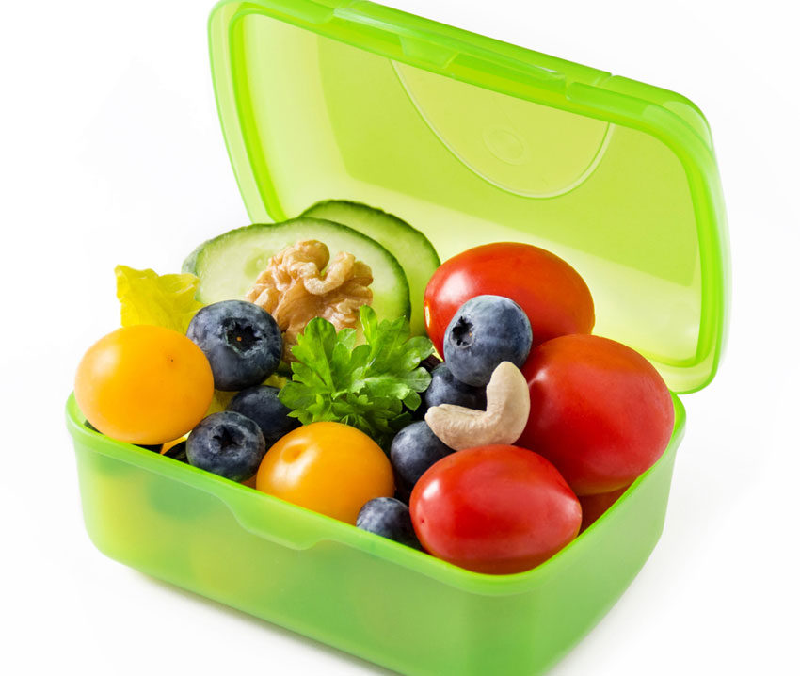
Did you get some nutrition / movement?
CHECK OUT MS. MAY’S MENTAL WELLNESS IDEAS – IN GOOGLE CLASSROOM
NEW - DID YOU SEE MR. FAFARD’S SUGGESTIONS ON FRESHGRADE?

Slide 23
Check It Out – Our Amazing Website!
STUFF FOR YOU, STUDENT
New Resources – especially for GOOD READS
STUFF FOR PARENTS!

Slide 24
FRIDAY Welcome Mrs. Nunes
Let’s Plan Lyrics for Our Parody
PM
End of the Week “Check In”

Slide 25
Meetings Friday 8:30 a.m. w/ Mrs. Nunes Lunch Invite 11:15

Slide 26
Stay Connected!

